Slide 1

SAP Analytics Cloud
SAP
March 2024

Slide 2

Analytics and BI market dynamics
Organizations are striving to be more intelligent and sustainable
Data and analytics leaders are now the new business leaders of today
Notes:
Analytics and BI has topped CIO’s priority agendas for many years. This is not changing any time soon. More than ever, data is really fueling the business priorities and the transformation of organizations today. Whether that comes to being more sustainable as a company, creating new user experiences to better serve the needs of customers, employees and society, or getting value from generative AI, it really comes back to data driving that digital transformation.
The ability of organizations to get value from all the data they create is as essential today as business basics like capital management and resource planning. As the volume of data surges within the enterprise, analytics and BI is becoming a critical driver of growth. With data and analytics becoming increasingly important, data and analytics leaders are really now the new business leaders of today.
According to leading industry analyst firm IDC, the global Big Data and Analytics (BDA) software market is expected to grow from $105Bn to $253Bn in 2027 with +19.3% CAGR. (Worldwide Big Data and Analytics Software Forecast, 2023-2027, IDC, Jul 2023)
The BDA software market is made up of five primary segments:
Analytics and business intelligence (ABI) tools and platforms
Enterprise performance management (EPM) and analytic applications
Analytic data management and integration platforms
Location and geospatial data management and analytics software
Artificial intelligence platforms, content analytics tools, and search systems
The analytics and BI market has significantly evolved and expanded through multiple waves of disruption and influence from self-service data discovery to AI infusion and unification of data and analytics.

Slide 3


Analytics and BI adoption is limited to analysts and power users
From < 20% adoption in the 90’s…
More focus on the needs of the analytics consumers and decision makers is needed
Enterprise-wide adoption requires closing the last mile of consumerization
Embedding analytics and BI in all business and productivity applications is needed
…to < 35%
adoption today
Notes:
Key changing customer need / market trend #1
Augmented BI is becoming ambient and actionable for wide enterprise adoption. Traditional enterprise BI — with a rich semantic layer, OLAP, and GUI — only moved the market to about 20% adoption among decision-makers (primarily analysts and so-called “power users”). The next goal is to further democratize data and analytics for the other 80% — the non-data pros — via techniques such as conversational UI and ambient BI (embedding BI capabilities in all business and productivity applications or enabling subscriptions to ML-generated alerts). Additionally, embedding actions into BI applications enables users to assess impact and drive adoption. [Forrester, ABI Platforms 2023]
The ABI platform market will increasingly need to focus on the needs of the analytic content consumer and business decision makers. To achieve this, automated insights must be relevant in context of a user’s goals, actions and workflow. [Gartner, ABI MQ, 2023]
BI is evolving to support “Generative AI” innovations and “Decision Intelligence” where analytics and data visualization will be embedded in business applications at the moment decisions are needed. This shift will make sizing the analytics opportunity
Many platforms are adding capabilities for users to easily compose low-code or no-code automation workflows and applications. This blend of capabilities is helping to expand the vision for analytics beyond simply delivering datasets and presenting dashboards. [Gartner, ABI MQ 2023]
Composable BI is emerging from the embedded BI submarket and is a important driver of adjacent market opportunity for analytic application development with low code / no code automation workflows.

Slide 4

The analytics and BI pendulum is swinging back
User-sourced shiny self-service data viz tools led to disconnected data and analytics silos
Faith in analytics is at risk, limiting adoption and fact-based decision making
Governance and scalability are the key drivers of the new equilibrium
4
Notes:
Key changing customer need / market trend #2
The pendulum that had been favoring more distributed self-service data visualization is swinging back to the center and perhaps settling on a hybrid, semi-centralized approach for enterprise analytics and BI. Off-platform self-service tools and separate data extracts have spread data silos disconnected from the context of the business processes where the data originates. Throughout the organization, people lose faith in enterprise data while decision-making reverts to gut feeling rather than facts. This defeats the very purpose of analytics and BI. Governance and scalability are the key drivers of this new equilibrium.
Other key market trends include the need for improved governance of analytic content creation and dissemination, and the demand for a headless, open architecture. [Gartner, ABI MQ 2023]

Slide 5

Maximizing the efficiency of analytics and BI
Organizations need to support the diversity of data, decisions, and decision makers
All-in-one solutions covering the full closed-loop decision-making process are needed
End-to-end data and analytics in the cloud empower agility and future-proof investments
Notes:
Key changing customer need / market trend #3
Today’s winning organizations hyper optimize to maximize the efficiency of all business operations – including analytics and BI – maximizing business value and impact while reducing cost.
Everyone makes decisions – some are strategic, some are operational and some are tactical. You need to support the diverse, decision-making needs of your entire organization comprised of different types of people and decisions to maximize impact.
There are a number of steps in making a data-driven decision. Depending on who you are and where you are at in the process, you may start on any point of the continuum. You may start with a question that needs answering, or you may have received an alert that prompts you to investigate. Then you analyze what’s happening, you predict what’s likely to happen next, and you plan accordingly. Plans lead to action, and then you report on results. In order to serve the needs of all types of decision makers in an organization, an analytics solution needs to have all these capabilities. If not, the result is a lack of evaluating alternatives, understanding risk and constraints, and prescribing the right next best action.
Decision making today is complex, with data coming from multiple data sources residing in different clouds. Relevant data can be unavailable to a wide variety of business stakeholders. Excessive time is spent on integrating data and recreating business logic and organizations lack agility due to bottlenecks. Technology costs can skyrocket. So, organizations want all-in-one data and analytics as a hub with cloud connectors to multiple business applications and prebuilt data models for more agility, they are widely adopting data and analytics platforms in the cloud with built-in data and analytics content. They empower business and IT stakeholders to drive agility and data democratization while future-proofing investments thanks to high pace of innovations in the cloud.

Slide 6
High expectations on the business value and impact of generative AI
Analyze
Predict
Create
Generative AI is giving rise to new and restored expectations on analytics and BI
Managing stakeholder expectations and fear of missing out on GenAI is a big stressor for data and analytics leaders
Statistics
Machine Learning
GenAI
Business value and impact
… - 2000’s
2010’s
2020’s
Notes:
Key changing customer need / market trend #4
The well-established Analytics and BI market is evolving to include augmentation through AI-infused automated insights as well as more sophisticated and tighter integration with data and data management capability, beyond data wrangling.
2023 was the year of generative AI. Yes, the world was made aware of GenAI when ChatGPT was publicly launched in November of 2022, but few knew the impact it would have at that point in time. Since then, GenAI has taken the world by storm with vendors applying the technology to make it easier to ask questions about data, making it easier to write code / SQL, making it easier to prepare data for analyses, making it easier to document data pipelines and making it easier to use software products in general. It may finally be the advent of conversational computing.
The surge of generative AI capabilities brings the collision between data and analytics spaces to an unprecedented level, giving rise to new and even restored expectations around analytics and business intelligence (ABI) innovations. The impact of generative AI in ABI not only creates new technology, such as generative analytics experience, but also restores the expectations on other technologies, such as natural language query (NLQ), augmented analytics and natural language generation (NLG). [Gartner, ABI Hype Cycle 2023]
Future growth will depend on the ability to address demand for AI-infused analytics, which has been defined as the use of machine learning (ML) methods to automate steps in the BIA process. Technology providers need to have a clear roadmap of how they plan to leverage AI/ML to help users automate steps of the analytics workflow, enhance human-computer interactions using natural language query, and generate explanatory narratives of analysis results. [IDC, ABI Market Analysis Perspective 2022]

Slide 7
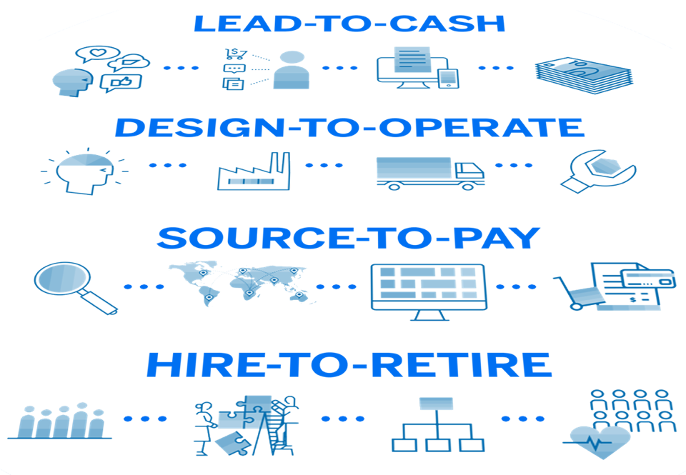
SAP data is the most valuable enterprise data
Created from the most important processes
Informing the most impactful decisions
Analytics and BI must connect to SAP LOB apps to maximize the value of your SAP data
Notes:
SAP data is the most valuable (enterprise) data, created from the most important (business) processes, informing the most impactful decisions. ​
SAP customers generate 87% of total global commerce ($46 trillion) – Source: SAP Corporate Fact Sheet, October 2023
Even for us (SAP), with 50 years experience of best practices, expectations are higher than ever before. Business stakeholders are more demanding. Enterprises must be more agile. And new technology is promising to be faster, better, cheaper, cooler.
Your analytics and BI platform must connect to your SAP application landscape to maximize the value of your SAP data. There’s been a fundamental error – focusing on the technology rather than the data. In fact, data has been moved to serve the technology rather than technology brought to the data. Like a tree, torn from the forest because we think it will look better in the garden, data uprooted from its business environment loses context, loses its most basic business framework and loses value. It’s no surprise that data preparation, data integration, and data quality work can make up 80% of the effort of a typical analytics and BI project – people are trying to recreate all that context that’s been lost. We’re expensively feeding and watering a tree that never before needed it. There is a better way to transform your business, by bringing new technologies – and new data - into the context-rich environment of existing business systems. You want to run live queries to SAP data sources and apps with the most functional and best performing integration, and without moving data out.

Slide 8
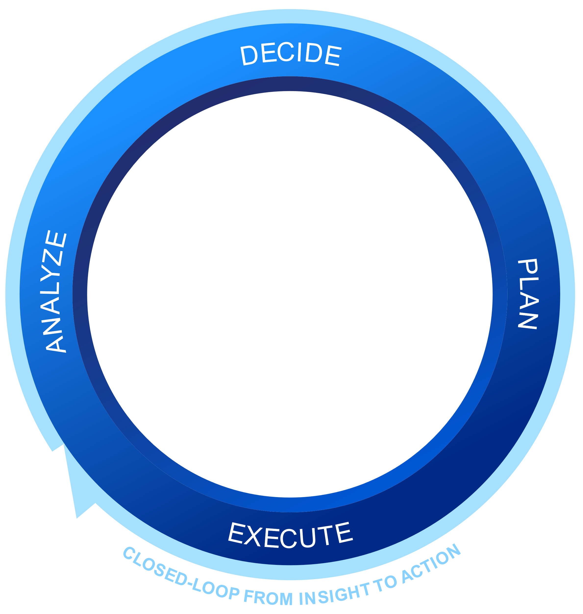
















SAP Analytics Cloud
Make decisions without doubt
Use cases
Enterprise Planning
Analytics and Business Intelligence
LEAD-TO-CASH
Augmented | Machine-generated analytics and insights with ML and generative AI
DESIGN-TO-OPERATE
Collaborative | Collaborative decision making and goal-oriented alignment
SOURCE-TO-PAY
Embedded | Planning and analytics at the point of decision in SAP applications
HIRE-TO-RETIRE
Extensible | Low-code/no-code composition, APIs to integrate everywhere
Optimized | Unique integration to SAP applications and data sources
SAP and non-SAP data
On-premise
Multi-Cloud
Hybrid

Slide 9
SAP data and analytics
Open ecosystem
Multi-cloud
Business Data Fabric
Deliver semantically-rich, trusted data to every data consumer with business context
and logic intact
Intelligent Data Applications
Empower developers to build apps that
utilize generative AI, are context-aware,
and connect to vital business data
Extended Planning and Analysis
Connect finance, HR, operational, and strategic planning with data and analytics
on a single stack
Extended
Planning and
Analysis
Intelligent
Data
Applications
Users
Business
Data Fabric

Slide 10
Strategic directions: portfolio integration, next-gen front-end, generative AI
SAP BTP and
portfolio integration
Planning and simulation
Composable analytics
Live connectivity
Data exploration
and analysis
Unified story
Performance and
administration
Add-in for Microsoft 365
Generative AI

Slide 11
Strategic directions: portfolio integration, next-gen front-end, generative AI
SAP BTP and
portfolio integration
Planning and simulation
Composable analytics
Deep integration with SAP Datasphere and portfolio of business applications
Flexible modeling, data entry optimization, predictive planning and forecasting, multi- actions and enhanced workflows
Integrate in context analytics into any kind of business application
Live connectivity
Data exploration
and analysis
Unified story
SAP data sources and portfolio of business applications: BW, BPC, HANA, Datasphere, S/4HANA
Data analyzer as the one exploration experience with integration into story workflow and analytics catalog
One experience combining stories, analytics designer, and use cases of SAP Digital Boardroom
Performance and
administration
Add-in for Microsoft 365
Generative AI
High performance and scalability with new lightweight viewer, enhanced administration and governance
Full support of planning features in Excel with data actions, new lines, and more
Generative AI for data exploration and analysis, story/app creation, decisioning and simulation, planning and modelling

Slide 12

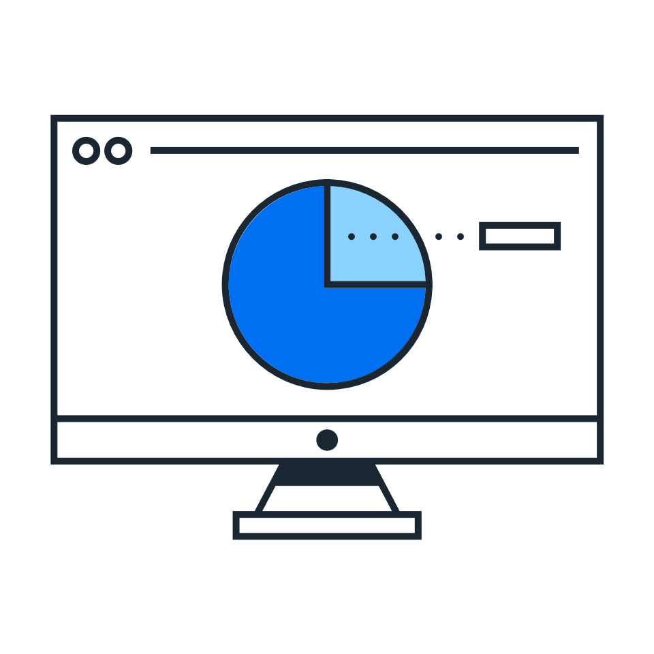
SAP Analytics Cloud
Make decisions without doubts
Infuse trusted AI
Deliver mission-critical analytics
Transform enterprise planning
Embrace the power of generative AI to automate reporting, discover hidden insights, and create and develop business plans with Joule copilot
Elevate BI capabilities and deliver industry-specific analytics with pre-built business content
Enable collaborative planning by unifying financial, supply chain, and operational planning with a single solution

Slide 13

Infuse Trusted AI
Enhance decision-making with trusted AI
  Run analytics & planning with SAP’s GenAI copilot, Joule, for efficient data analysis, risk assessment, & scenario modeling
Discover insights using natural language
  Empower business users to get instant and accurate answers about their data by asking questions using natural language
Simplify complex tasks and automate workflows
  Generate scripts to augment stories and enrich data models with customized calculations using generative AI
Notes:
Infuse trusted AI
Embrace the power of generative AI to automate reporting, discover hidden insights, and create and develop business plans with Joule copilot
Enhance decision-making with trusted AI
Perform analytics and planning tasks using the Joule copilot and generative AI for efficient data anlaysis, risk assessment, scenario modeling, and more
Discover insights using natural language
Empower business users to get instant and accurate answers about their data by asking questions using natural language
Simplify complex tasks and automate workflows
Generate scripts to augment stories and enrich data models with customized calculations using generative AI.

Slide 14
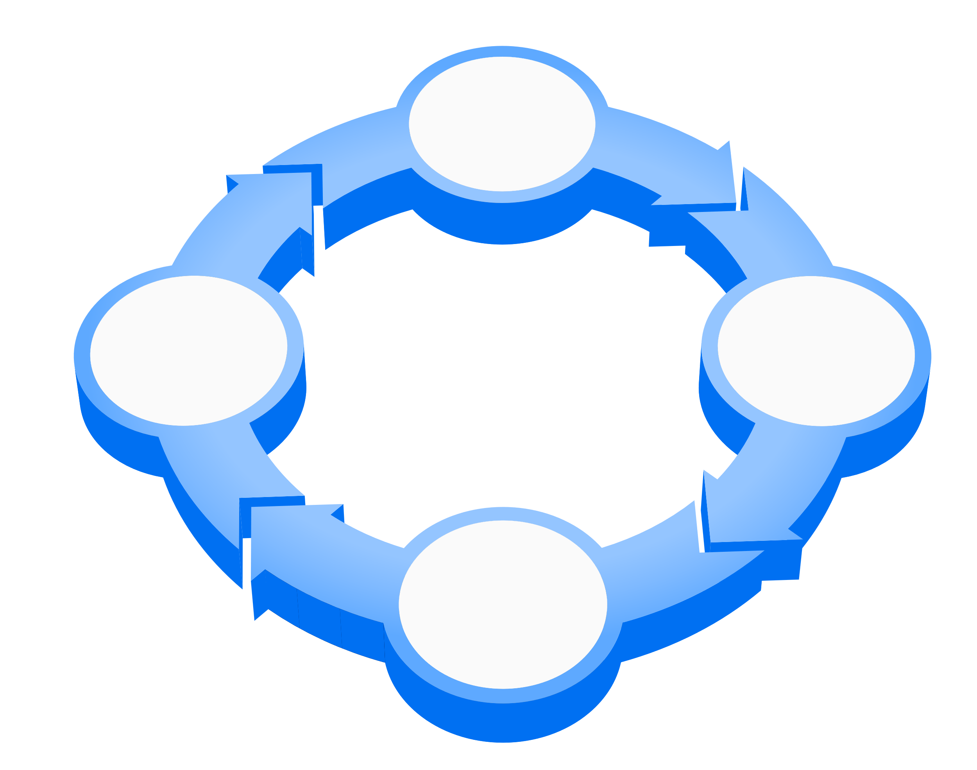
Predictive Planning
An end-to-end experience
Source data (actuals)
Planning Models
Source data (actuals)
  Historical data is being brought into the planning models from the source systems
  Predictive scenarios are created using planning model data
  Predictive forecasts are saved into planning versions and consumed by wide planner groups
  Stories can include predictive forecasts side by side to actuals, plans, and budgets
  Export data to BW, S/4, HANA, Datasphere or any ODATA-compliant data source
Data Sources
SAP Analytics Cloud Predictive Planning
Predictive Scenarios
Planned data
Stories
Predictive forecasts
Notes:
[Slide notes] So what's SAP value proposal here? Using SAP Analytics Cloud Predictive Planning you can:
- use your planning models as a foundation for predictive forecasting
- predictive forecasts are saved into regular planning versions and consumed into stories, side to actuals, plans & budget information
- beyond SAP Analytics Cloud, forecasted & planned data can be exported back to the source systems

Slide 15

Deliver Mission-Critical Analytics
Accelerate time to insight
  Deliver dashboards and reports quickly by leveraging pre-built business content for your industry or function
Deliver insights with full business context
  Provide self-service analytics across all data sources, while keeping semantics of mission-critical business processes
  Access insights wherever your data resides
  Integrate with native connection to SAP Datasphere to access insights across your data landscape
Notes:
Deliver mission-critical analytics
Elevate BI capabilities and deliver industry-specific analytics with pre-built business content
Accelerate time to insight
Deliver dashboards and reports with pre-built business content such as KPIs, models, and data flows for your industry or function—from spend management to workforce capital.
Deliver insights with full business context
Provide self-service analytics across all your data experiences, while maintaining semantics of mission-critical business processes
Access insights wherever your data resides
Integrate with native connection to SAP Datasphere to access insights across your data landscape, as well as SAP S/4HANA for a live view of financial inisghts.

Slide 16





Analytics for the intelligent enterprise
Enterprise analytics provides rich cross-LOB analytics insights. Get started quickly with pre-built accelerators.
Human Capital Management
SuccessFactors Employee Central
SuccessFactors Workforce planning
Sales Performance Management
…
Customer Relationship Management
Sales Cloud
Service Cloud
Marketing Cloud
…
SAP Analytics Cloud embedded in most SAP cloud solutions
SAP Analytics
Cloud
Cloud ERP
S/4HANA Cloud
Integrated Business Planning
Digital Manufacturing Cloud
…
SDK and APIs can be used programmatically to embed, build, extend, and manage the lifecycle of analytics.
Spend Management & Business Network:
Ariba
Concur
Fieldglass
…

Slide 17
Unique strengths for data and analytics workloads
Open data access
  Open, live access to all data – SAP and non-SAP, virtual or physical storage – wherever it resides
Shared business semantics
  Rich semantic modeling with analytic model consumption and no duplicate modeling
Comprehensive self service
  Self-service D&A beyond departmental siloes to enterprise grade
End-to-end governance
  Centralized administration and complete D&A catalog with company-wide data lineage and impact analysis
Harmonized user experience
  Easier, faster onboarding and expansion
Shared business semantics
Comprehensive self-service
End-to-end governance
SAP Analytics Cloud
Harmonized UX
Open data access
SAP Datasphere

Slide 18

Transform Enterprise Planning
Run complex, data-driven simulations & forecasting
  Detect plan anomalies, simulate course corrections, and automate accurate forecasts to take the next best action
Power x-organizational planning with SAP Datasphere
  Break down siloes between planning departments with one tool for data preparation, modeling, planning, and analytics
Implement extended Planning & Analysis (xP&A)
  Plan across all LoBs by combining transactions, analytics & planning with S/4, SuccessFactors, IBP, and third-party data
Notes:
Transform enterprise planning
Enable collaborative planning by unifying financial, supply chain, and operational planning with a single solution
Run complex, data-driven simulations and forecasting
Detect plan anomalies, simulate course corrections, and automate accurate forecasts to take the next best action with SAP Analytics Cloud compass.
Power cross-organizational planning with a single data management system
Break down siloes between planning departments with one tool for data preparation, modeling, planning, and analytics with SAP Datasphere integration
Implement extended Planning & Analysis (xP&A)
Plan across all lines of business by combining transactions, analytics, and planning with SAP S/4HANA, SAP SuccessFactors, SAP Integrated Business Planning for Supply Chain, and third-party data

Slide 19




Accelerate delivery of industry-tailored analytics
Leverage pre-built out-of-the-box content packages with data models, transformations, calculations, and analyses for a variety of industry- and function-specific use cases
De-risk your project with best practices and accelerate time to insights by simplifying the implementation
Integrate with external data providers and third-party data sources with out-of-the-box connectors
Human capital management
Enterprise resource planning
Customer relationship management
Spend Management & business network
Industry Focus
Function Focus
Retail
CPG
Finance
Order Fulfillment
POS Analytics
Demand Forecasting
…
Revenue Growth
Sales Target Planning
Replenishment Planning
…
Operating Cash Flow
Acct Receivable/Payable
Total Spend Analysis
…
…
…
Notes:
Deploy pre-defined content:
Ever-growing array of SAP- and Partner-provided content packages for LoBs and industries that span across the entire flow – from data ingestion to consumption with predefined dashboard
Re-use of data models with hybrid model transfer for SAP BW/4HANA as well as the ability to build on pre-defined views
External data integration through open interfaces to tools and growing number of external data providers that makes data sharing and consumption a matter of clicks

Slide 20
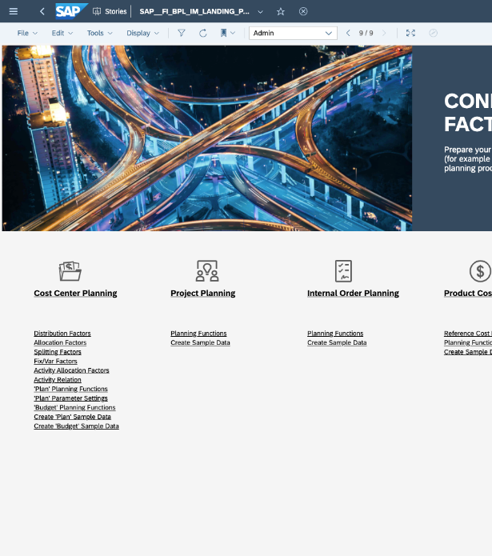
200+ Pre-Built Content Packages for LoB and Industry Use Cases
Line of Business | Industry | SAP Sources
Asset Management Environmental Health and Safety Experience Management Finance Human Resources Integrated Business Planning Liquidity Planning Marketing Procurement Product Cost Planning Project and Portfolio Mgmt Project Management Sales and Distribution Supply Chain Trade Management Transportation Travel & Expense Treasury Management Vendor Management + many more | A&D Agriculture Banking Chemicals Consumer Products Health Care High Tech Higher Education Insurance Mill Products Mining Oil & Gas Professional Services Public Sector Real Estate Retail Sports Telecommunications Utilities + many more | SAP Ariba SAP BW SAP BW/4HANA SAP Business ByDesign SAP Business One SAP Concur SAP Cloud for Customer SAP Datasphere SAP Fieldglass SAP Field Service Management SAP HANA SAP Integrated Business Planning SAP Integration Suite SAP Intelligent Asset Management SAP Marketing Cloud SAP Master Data Governance SAP Qualtrics SAP S/4HANA SAP S/4HANA Cloud SAP Solution Manager SAP SuccessFactors + many more
Find all content packages documented here.
Notes:
Leverage the collection of composable and modular business content for line-of-business and industry use cases

Slide 21
SAP Portfolio
SAP BTP is an
innovation platform optimized for SAP applications in
the cloud.
Notes:
SAP’s mission is dedicated to the advancement of people, technology, and business.
From pioneering enterprise resource planning fifty years ago… to becoming a global leader in building and implementing intelligent, sustainable business models today.
SAP is known for our innovative drive and duty to act with purpose. That mission still rings true today as customers navigate their digital transformation journeys.
The key to gaining true agility, though, is implementing a business centric platform that brings together all your applications, processes, and data into one unified environment.
SAP BTP is THE foundation on which our customers are accelerating their innovation – not just for today or tomorrow, but for years to come.
We’re continuing to see massive adoption of the BTP in both new and existing customers. In the past year, we achieved high double-digit growth that is far outpacing the market.
This equates to 17,300 customers and 1,500 partners that are live in the cloud, implementing BTP’s comprehensive portfolio of application development, automation, integration, data and analytics, and AI solutions.

Slide 22
Deliver data-to-value end-to-end instead of point solutions
SAP Analytics Cloud
Analytics Catalog
Centralized Portal
Mobile
iOS & Android
Microsoft 365 Integration
Excel & PowerPoint*
Enterprise Planning
Planning & forecasting
Collaboration & scheduling
Automated workflows
Predictive planning
Analytics & Business Intelligence
Data exploration
Dashboards & visualizations
Conversational analytics
Insights with ML & generative AI
Enterprise reporting
SAP & non-SAP data
On-premise
Multi-Cloud
Hybrid
*Q2 2024 This is the current state of planning and may be changed by SAP at any time.
Notes:
AVENTI
- icons? Try to make the slide pop a bit more

Slide 23
Analytics and Business Intelligence

Slide 24
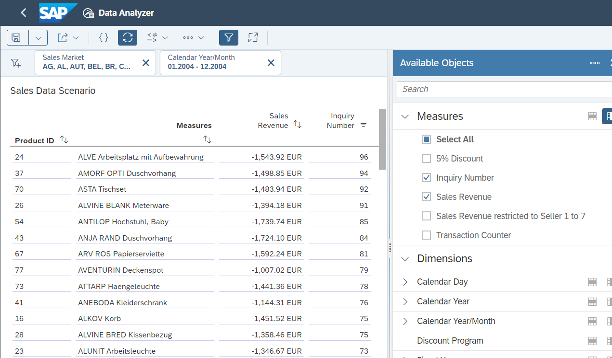
Data Analyzer
Query your data instantly and perform ad-hoc analysis in a pivot-table style analysis view
Standalone exploration tool with easy access from the side navigation bar​
Contextual exploration either in story overlay or new browser window
Explore your data visually in chart
Save Insights, share and publish​
Launch or share your data analysis
via URL parametrization

Slide 25
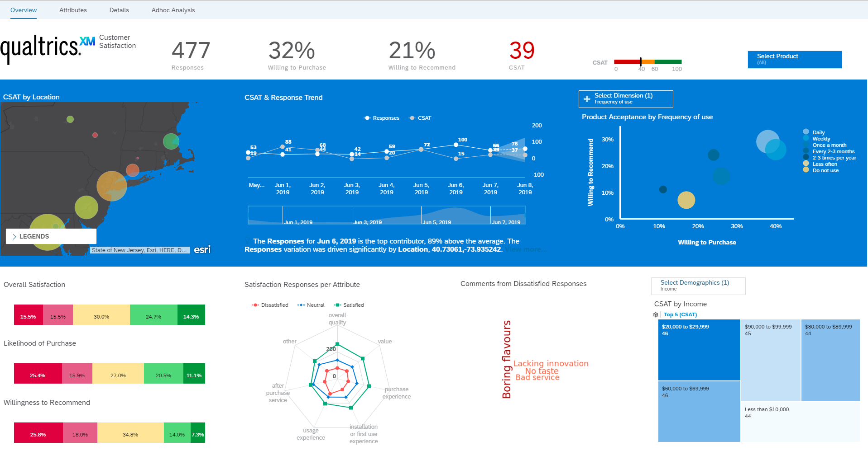
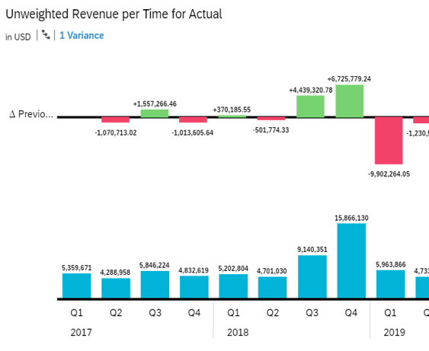
Dashboards & Visualizations
Design and deliver stunning, interactive enterprise dashboards across all lines of business
Extensive visualization library,
geo maps
Custom calculations, calculated dimensions, aggregations and more
Easily comment, collaborate
and share content
Highly Interactive with Linked Analysis, Ranking and Sorting, Filtering and Drill Functionality.
Notes:
Extensive visualization library, geo maps powered by ESRI and custom R visualizations
Define custom calculations, calculated dimensions, aggregations and more
Display variance, dynamic text, custom tooltips, CAGR and more
Easily comment, collaborate and share content via document link with other users
Highly interactive with Linked Analysis, Ranking and Sorting, Filtering and Drill Functionality.

Slide 26
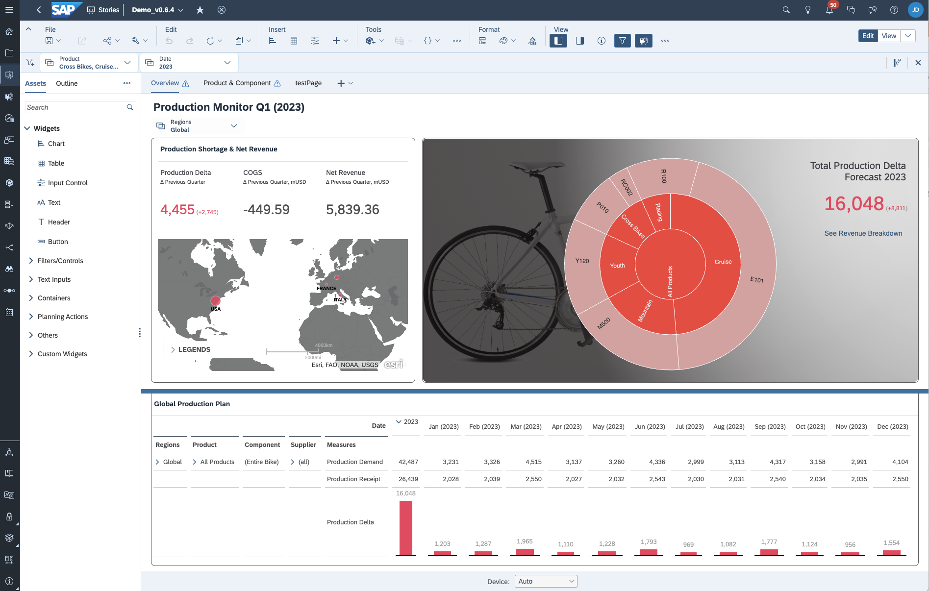
Story Extensibility
Fulfill unique and sophisticated use cases and workflows with advanced capabilities to extend stories and visualizations
Leverage advanced widgets and scripting capabilities to build flexible, guided reporting and planning applications
Define a custom user interface through themes and CSS capability
Utilize composites and templates to increase scalability and productivity
Extend the variety of story visualizations with custom widgets and widget add-ons

Slide 27
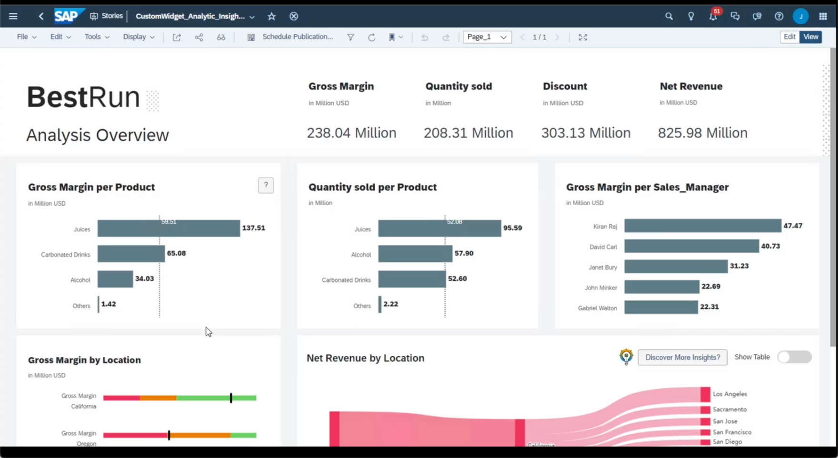
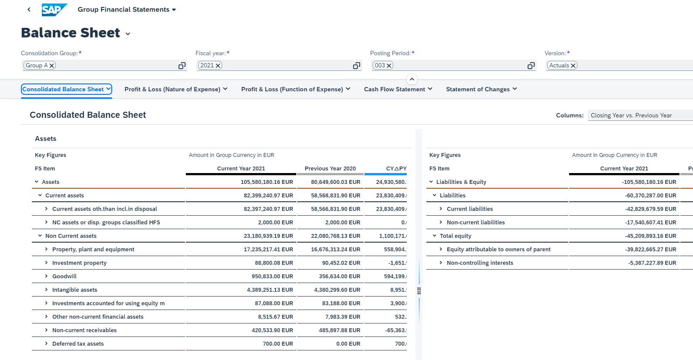
Composable analytics strategy
Two complementary options to drive adoption of analytics everywhere
Low Code Integration
Pro-Code Development
SAP Analytics Cloud software as a service can be consumed as a full standalone analytics product or embedded in applications using SAP developer tools.
Developers can embed analytics in applications using SAPUI5 developer library with no external service dependency. [Future]
This is the current state of planning and may be changed by SAP at any time.

Slide 28
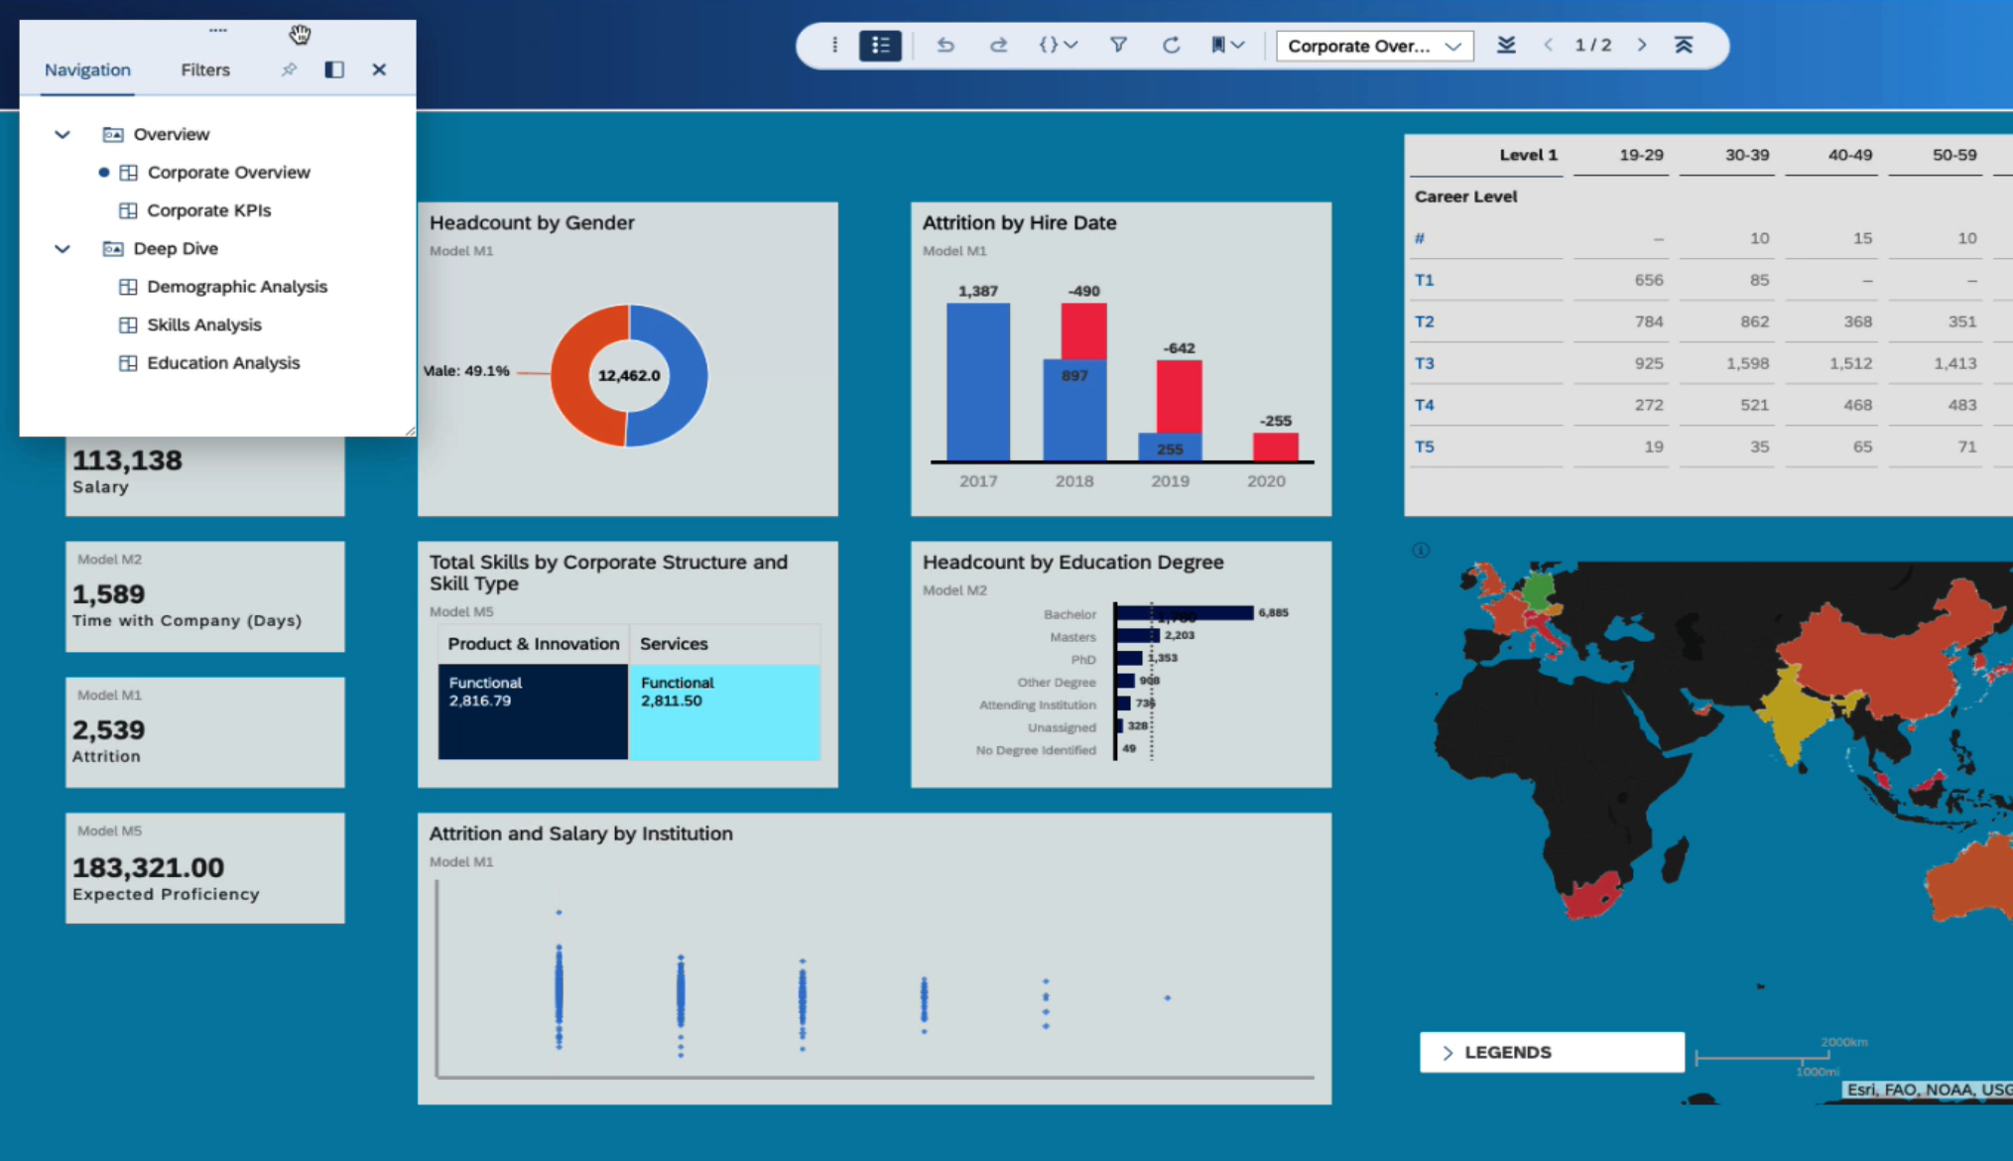
Story Presentation
Modern in-context user experience with continuous insights and collaboration.
Cross story navigation
360 degree view of the organization across diverse lines of business that promotes collaborative decision making.
Immersive presentation experience
Distraction free user interface that enables your users to focus on the insights.
Enabling decision makers to
steer their business clearly.
Note: GA is currently planned for Q2 2024 for desktop and H2 2024 for mobile.
This the current state of planning and may be changed by SAP at any time.

Slide 29
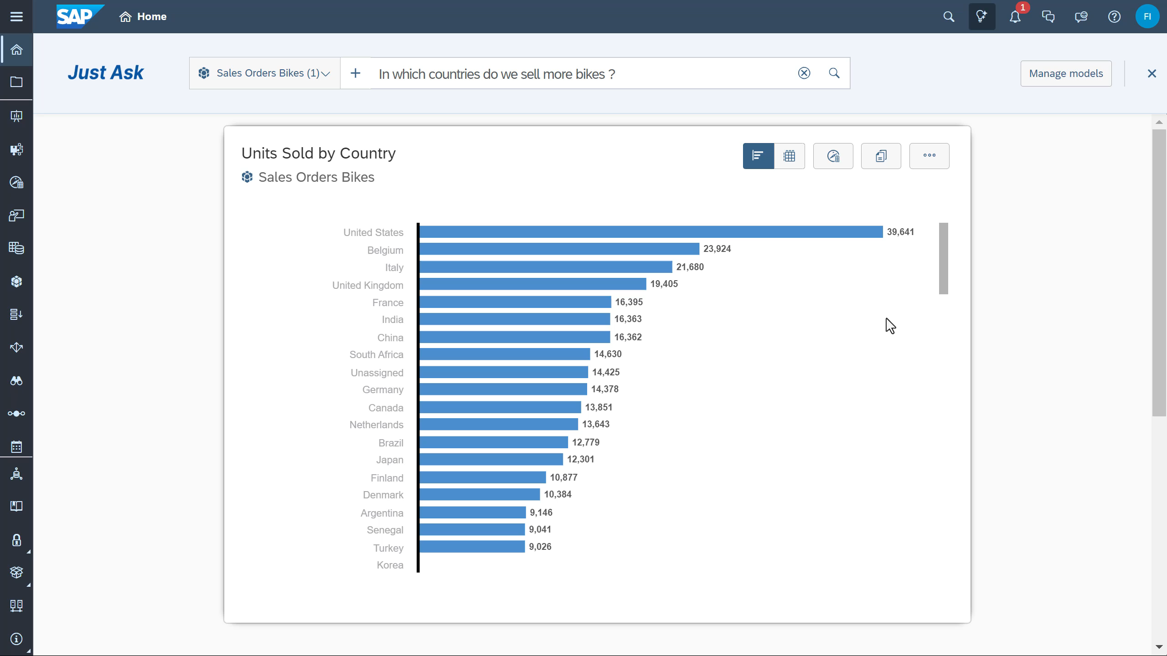
Just Ask
    Ask questions in natural language
    and get answers Immediately
    Get answers in charts and tables
    Leverage autocompletion, recommendation and sample questions
    Powered by AI, that automatically infer similar words based on meaning and generates query
    Custom synonyms for metadata and master data
    Information consumers to
    get answers on their own
Note: GA is currently planned for Q1 2024.
This the current state of planning and may be changed by SAP at any time.

Slide 30
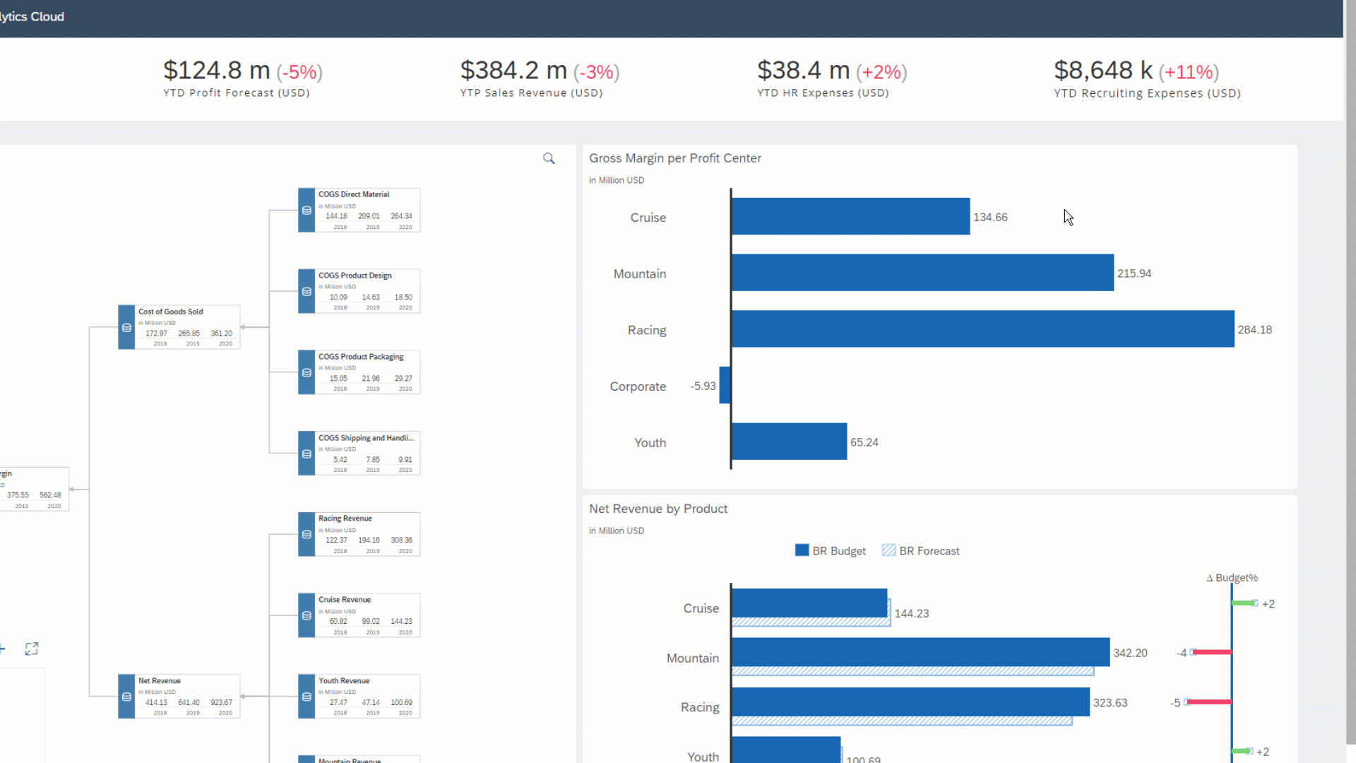
Smart Insights
Explain a data point or its variance
with top contributors
Deviation analysis across the data model
Based on dimensions cardinality
& hierarchies stats
In Context Insights for Businesspeople
Open up data exploration beyond
filter & drill
Natural language explains top contributors
Smart Insights
Notes:
Animated gif
Smart Insights is a workflow accelerator that allows a user to understand what drives a particular value (data point or variance)
The user can select a value and smart insights provides an explanation of that value based on the dimensions in the data .
The explanation will tell the user which values in their data (members in dimensions) influence the selected value.
For instance if we select a high point in sales revenue we may find that sales in China were the biggest contributor compared to other countries or that sales of iPhones were the biggest contributor compare to other products.
Smart Insights can be used to
Explain a data point
Explain a variance
Add an insight in text form to the footer of a chart to aid users in interpreting the chart.

Slide 31

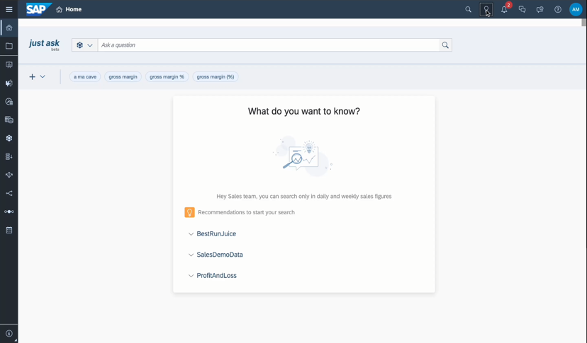
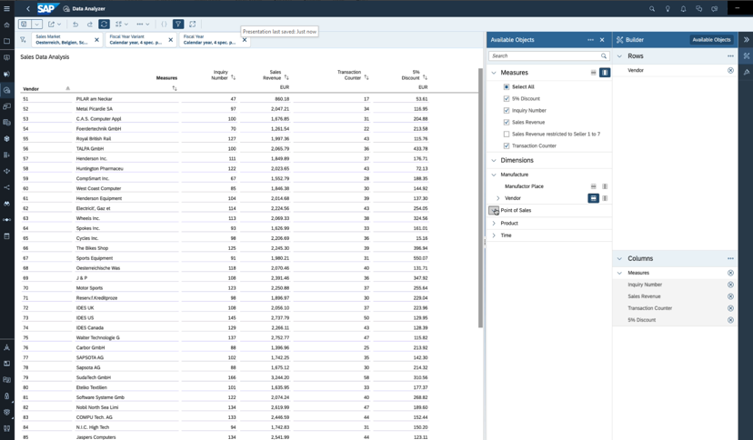
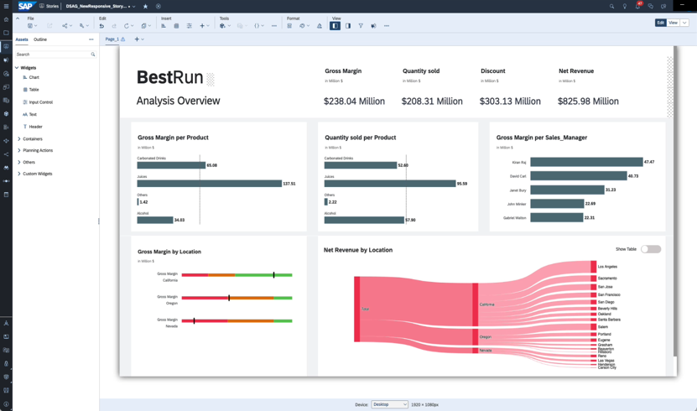
Generative AI is transforming analytics and planning
Generative AI for analytics and planning – statement of direction
Ask
Analyze
Create
Q1 2024 (GA)
Q2 2024
H2 2024
New NLQ experience, surpassing existing solutions
Joule AI assistant
for analytics use cases
Joule AI assistant for planning use cases

Slide 32
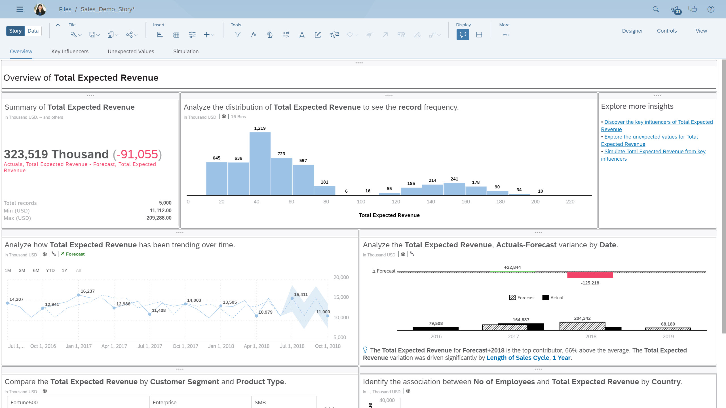
Smart Discovery
Leverage automated machine learning to discover patterns and relations in your data
Generates a dashboard based on
ML-driven insights
Uncovers trends, key influencers,
outliers and data distribution
Augments traditional data exploration, with a 360 degree analysis of your data
Smart Discovery
Notes:
Smart Discovery is an automated data exploration engine. Using machine learning algorithms, Smart Discovery reveals relationships and hidden patterns in your data model to drive accelerated insight discovery.
Benefits:
Quickly create a story which guides you to interesting trends
Never start from scratch again!
Spend less time on dashboard design and more time on insight discovery
Reduce human bias in analytics through machine guided analysis
Features:
The visualizations included in the overview page are determined by the type and content of the data
Automated predictive engine builds a robust model without Data Scientist intervention
Key Influencers, outliers and simulation pages are derived from the predictive model

Slide 33
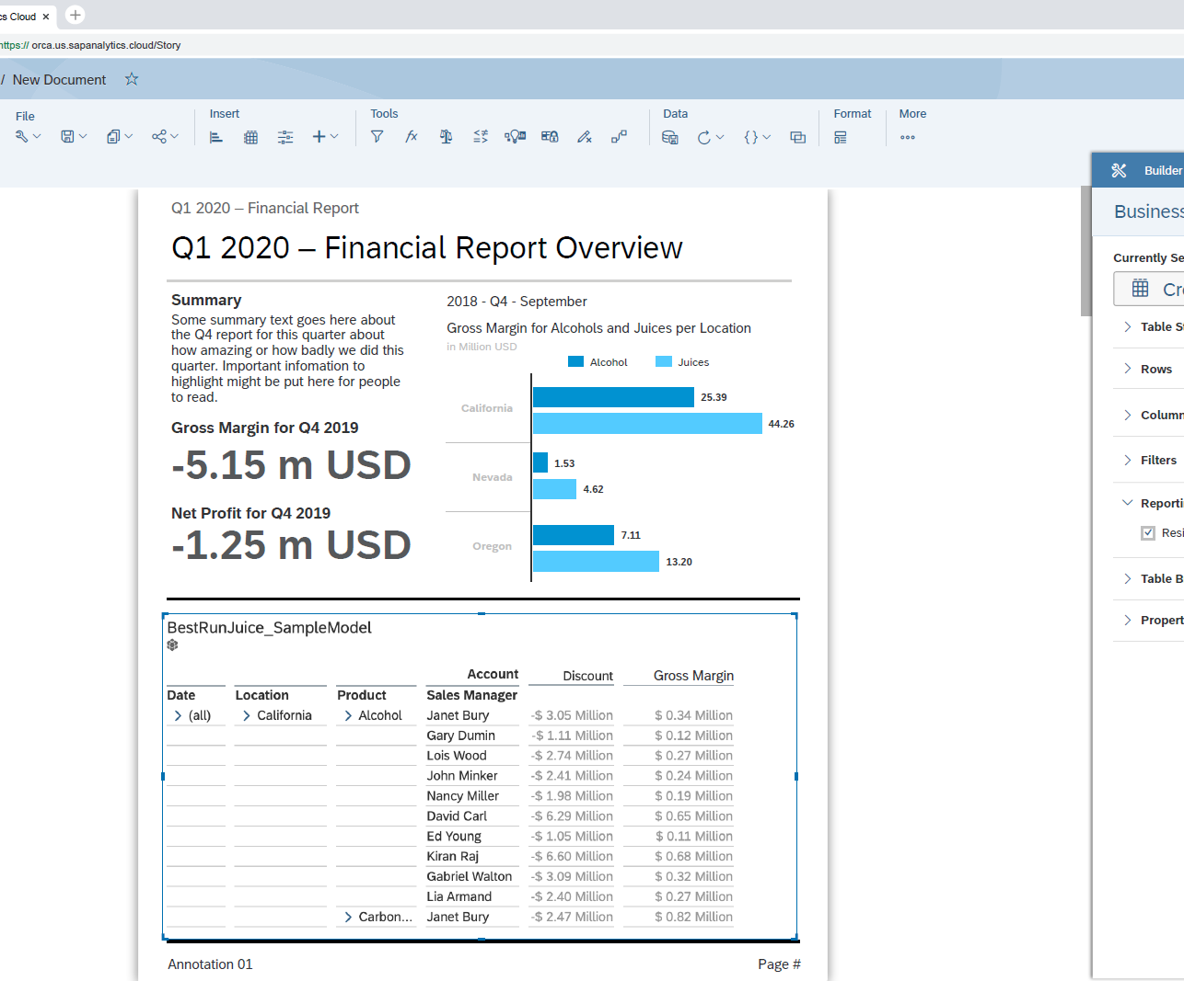
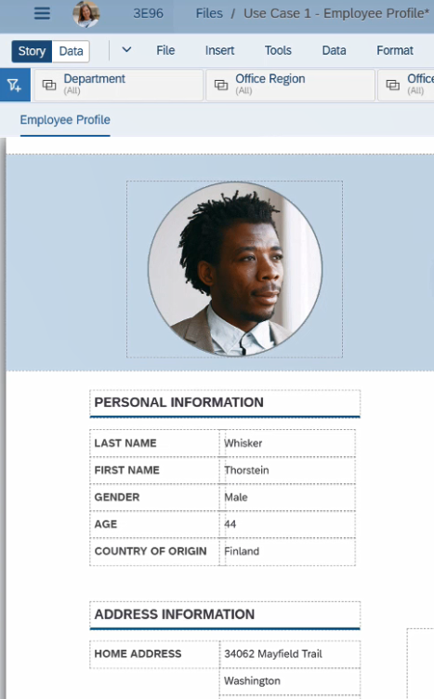
Enterprise Reporting
Design reports and distribute to the workforce on-demand or scheduled
Report Formatting
Multi-page reports
Report sections, headers and footers
Paginated export to pdf and pptx
Report Delivery
Schedule and distribute reports to SAP Analytics Cloud and non-SAP Analytics Cloud recipients
Burst personalized content to SAP Analytics Cloud recipients based on recipient authorization
Notes:
The main gap with BusinessObjects is reporting (pixel perfect, pagination, advanced formatting and mass distribution), but we are doubling down our investment to natively offer use cases in SAP Analytics Cloud

Slide 34
Enterprise Planning

Slide 35
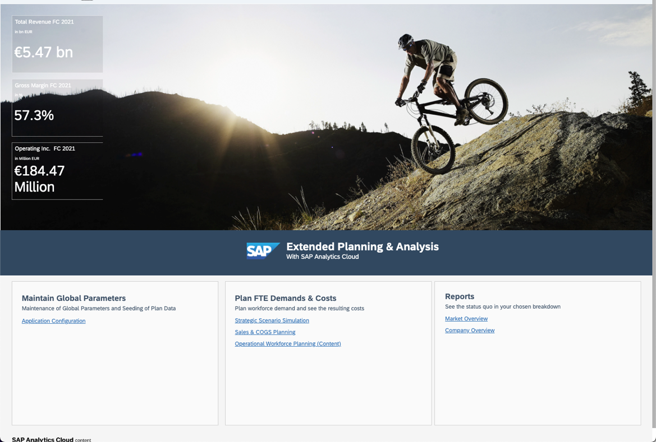
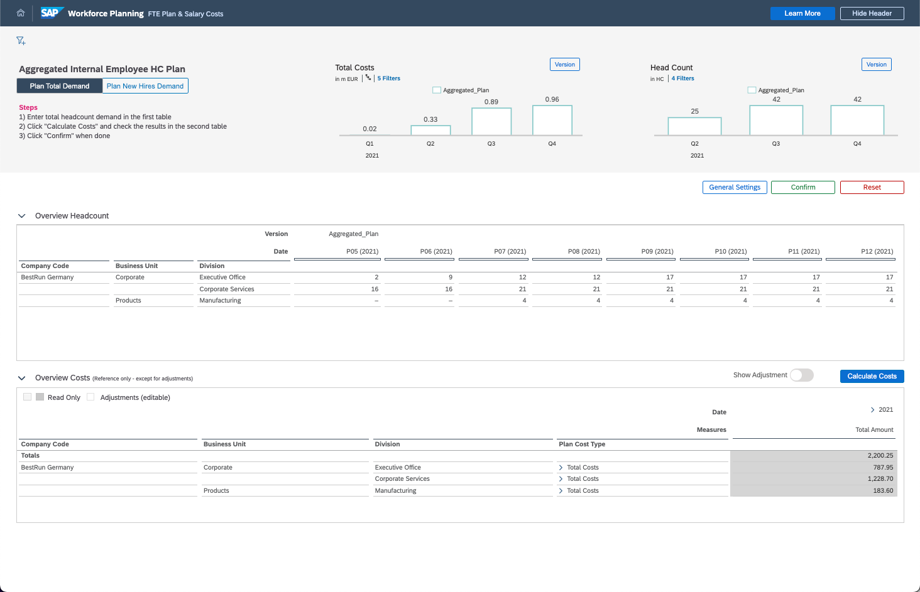
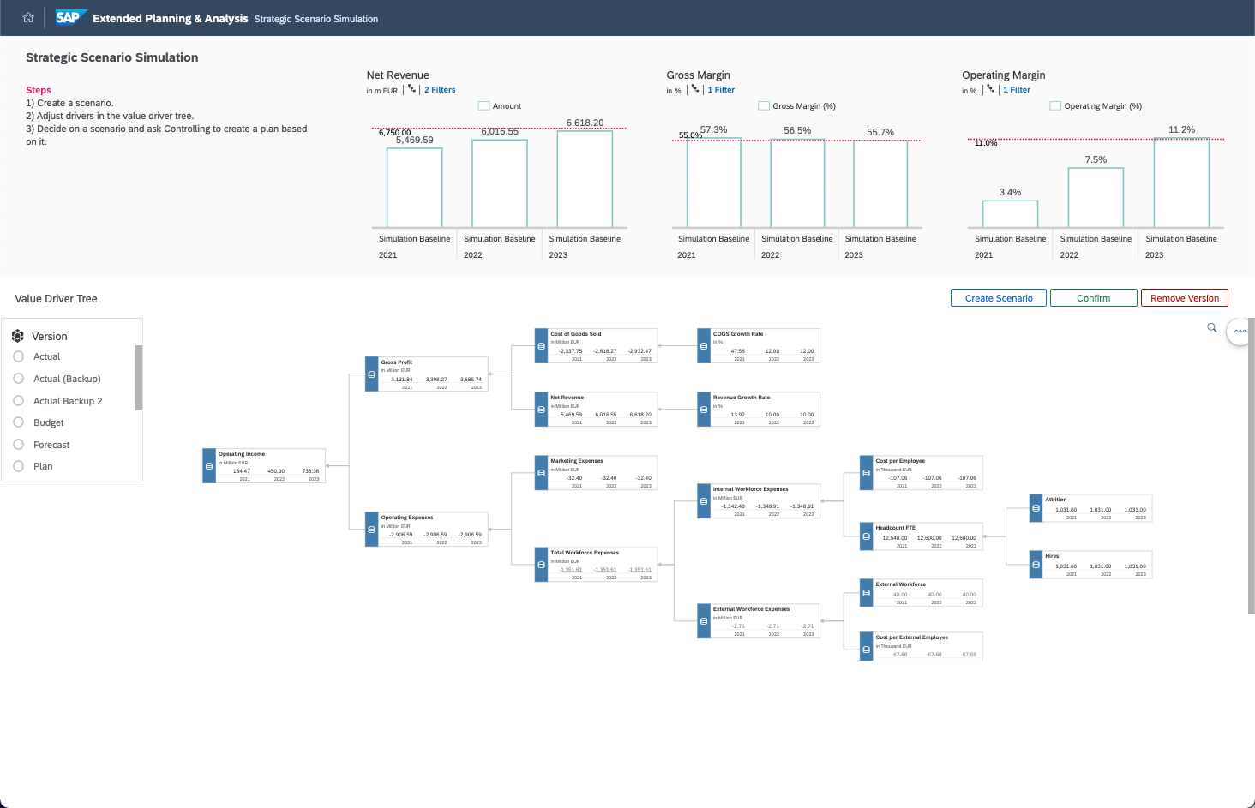
Enterprise Planning
Intelligent planning for the modern enterprise
    Planning & Analysis on a single platform
  Enterprise BI, Planning, and Predictive capabilities are augmented with rich collaboration capabilities to provide a full end-to-end Planning & Analysis experience
    Powerful planning capabilities with a few clicks
  Rich driver based planning, end-user versioning and simulations, robust scenario analysis, and end-to-end process management all combine to facilitate a more considered planning process
    xP&A for an Intelligent Enterprise
  Best-in-class connectivity to SAP solutions, including SAP S/4HANA and SAP Datasphere, with pre-delivered XP&A planning content allow all planning on a single platform with accelerated time-to-value

Slide 36


Harmonize heterogeneous data no matter where it resides
Planning and Analytics
Business Execution
BUSINESS INSIGHTS & PLANNING PROCESSES
Plan retraction for execution
CAPABILITIES
ACCELERATORS
Design to Operate
Strategy
Sales & Marketing
Lead to
Cash
Collaborate
Model
Proven Industry
Practices
Visualize
Analyze
Finance
Record to Report
Modular Packages
Live Analytics, (Master) data sync
Plan & Forecast
Predict
Workforce
Supply
Chain
Hire to
Retire
Source to
Pay
SAP BTP: Data orchestration, governance, automation and extensions
SAP Datasphere is the foundation for a business data fabric architecture. SAP Analytics Cloud complements it by providing a complete planning and analytics solution augmented by AI to transform data-driven decision-making using the data and semantics provided.

Slide 37
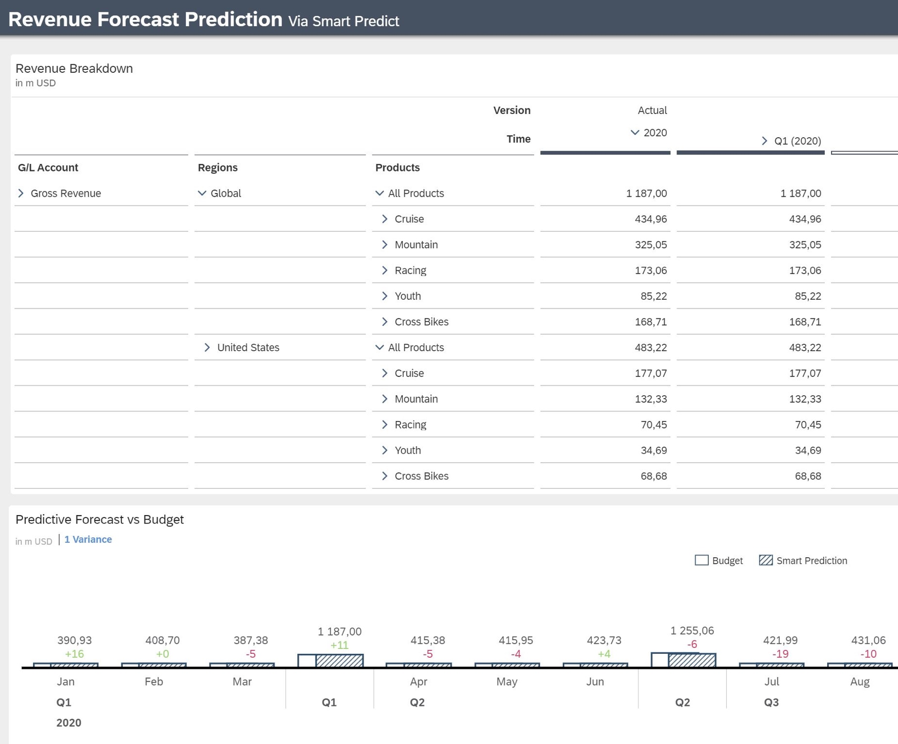
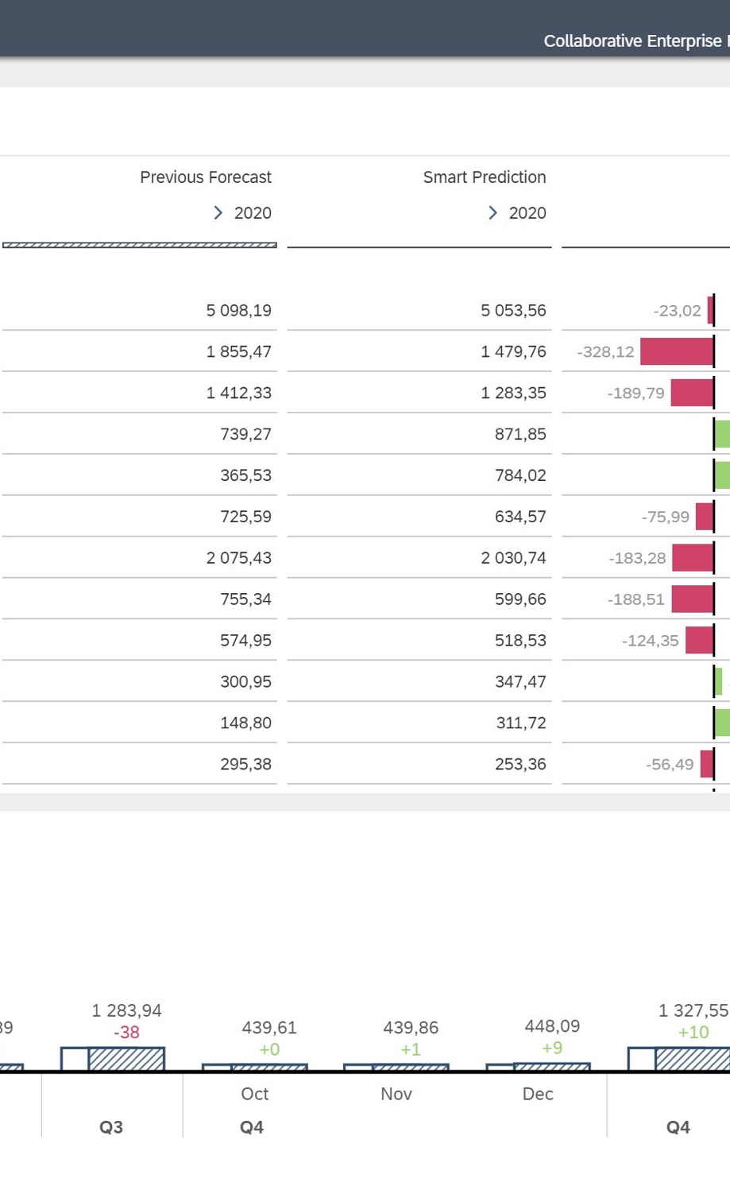
Predictive Planning
Combine the power of planning and predictive forecasting to accelerate planning cycles
  Planners generate accurate forecasts on top of actuals to accelerate their day-to-day planning activities
  Add predictive forecasts back to planning models to support data-driven business decisions
  All without the need for machine learning expertise
Video Blog
Notes:
https://www.youtube.com/watch?v=DuY2yQ9SqzQ
We combined the capabilities of planning and predictive, into what we call, Predictive Planning thanks to the feedback and request of our customers and partners. Their needs were around the ability to forecast sales, manage costs and plan for the evolution of their workforce.
Predictive planning will help augment and support the planning cycle and help planners make more confident decisions.
Smart Predict Time series models can use planning models as data sources.
Predictive planning brings the power of predictive to the office of CFO. It is the tight integration between Smart Predict and our planning workflows
Planners add predictive forecasts back to planning models to support data-driven business decisions.
Use Case
cash flow forecasting, resource management & planning
Revenue & Sales planning
What is the revenue forecast per business unit?
How will sales evolve for specific products in the future?
Headcount planning
How many employees will leave due to attrition or retirement next year?
How much will it cost to recruit replacements?

Slide 38
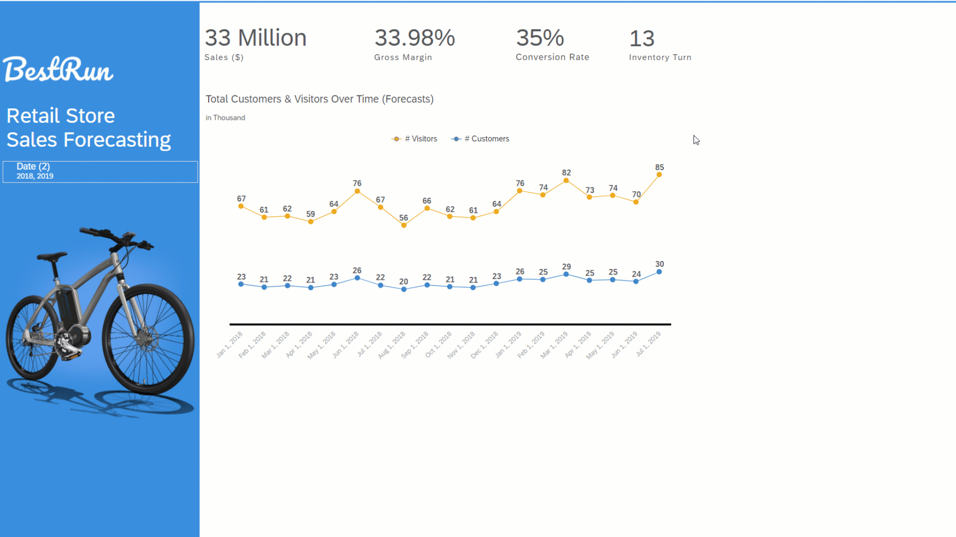
Time Series Forecasting
Predict future values of a series based on historical data to help you make more confident decisions
  Automatic forecasting on time series charts, line charts and planning tables
  Apply advanced options like linear regression, triple exponential smoothing and include additional inputs
  Forecast quality based on MAPE and is displayed as 0-5 rating
Notes:
Animated gif
Supported for live connections: The system configuration setting Live Data Models: Enable Smart Grouping and predictive forecasting in Time Series controls enabling forecasting for Time Series Charts and Line Charts on live data connections for a tenant.
Forecast quality
The 0 to 5 rating is based on a standard statistical quality measure of a forecast known as Mean Absolute Percentage Error or MAPE. The MAPE is expressed as a value between 0 and 1 with a high-quality forecast having a MAPE close to 0.
Additional Forecast Inputs can be used by the Automatic Forecast algorithm to improve the accuracy of the Forecast.
They are calculated measures, measure input controls or additional measures from your data model that you want to consider when creating a forecast.
The option of using additional inputs is only available for Time Series Charts.
Values for selected measures must be available for the historical periods and for the future periods for which you wish to forecast.
For example, if I am forecasting my Total expected Revenue and I want to include No of Customer Meetings as shown in Additional Forecast Inputs may improve the accuracy of the forecast, but this is not always the case as if the additional inputs do not improve the quality of the model they will not be used.

Slide 39
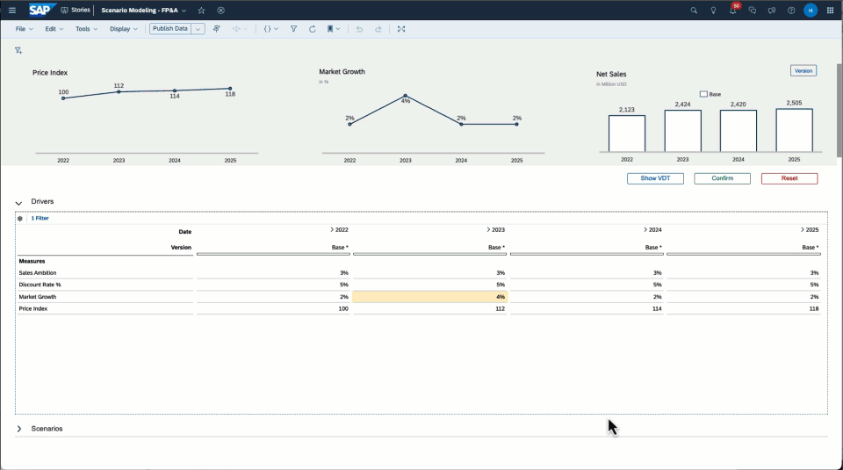
What-if Analysis & Simulation
Use version management capabilities to create scenarios and simulate outcomes
  Create multiple versions to reflect
  different scenarios (e.g., best case,
  worst case, expected)
  Make top-down or bottom-up changes
  Step backward and forward through data changes and see the impact in real-time
  Perform what-if visually using value
  driver trees
  Compare different versions inline using charts, tables or value-driver trees
Notes:
Answer questions like:
What if you increase discount by 20%?
What if you hire more staff?
What if costs of goods increased?²

Slide 40
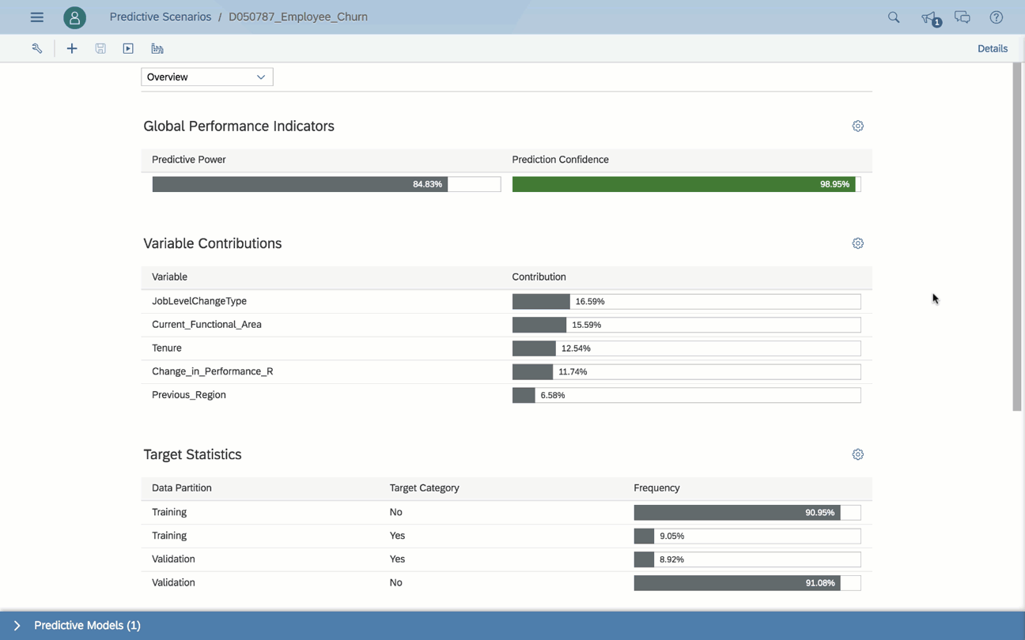
Smart Predict
  Build trusted and actionable predictions without the help of a data scientist
  Classification: “Create a sorted list of prospects to focus on for this product"
  Regression: "Give me revenue estimates for each customer for the next 6 months"
  Time Series: "Forecast revenue for each product and each point of sales daily for the next 30 days"
Notes:
To help business users/analysts to make better decision we have decided to integrate predictive features deeply into our SAP Analytic Cloud solution, through a high level of automation. Smart Predict provides business/analysts with solutions to generate sorted lists based on expected probability (classification models), or estimates about future or unknown values (regressions models), or forecasts (time series forecasting models). These predictive models are just a means to an end, and the end is to generate future, hidden, or unknown data. The result of a predictive workflow is data generated and ready to be consumed by other parts of the business process. Insights can be found and promoted to the end user for trust building purpose in the 'debrief information’.
We are at a point now where Smart Predict can be used on various acquired sources (and on HANA Live source in Q4 2019), to help the users to answer precise questions such as:
Classification: "Give me the sorted list of prospects to focus on for this product"
Regression: "Give me the estimates of revenue for each customer in the next 6 months"
Time Series: "Forecast the revenue for each product and each point of sales daily for the next 30 days

Slide 41
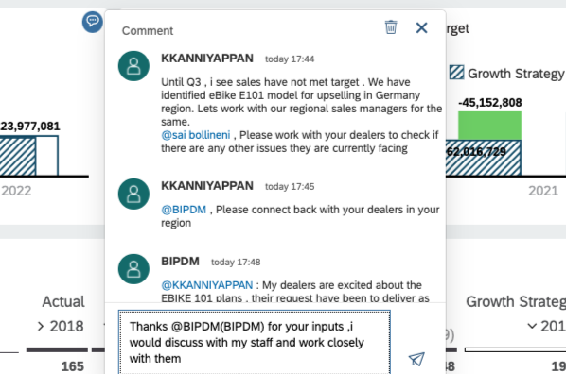
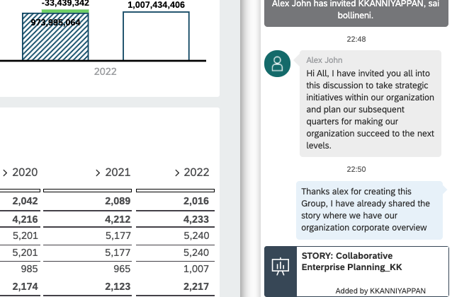
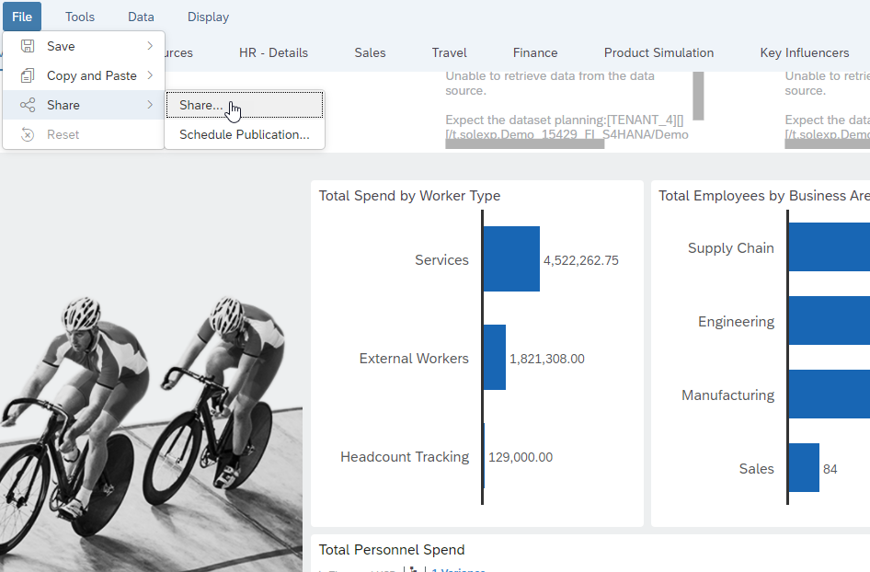
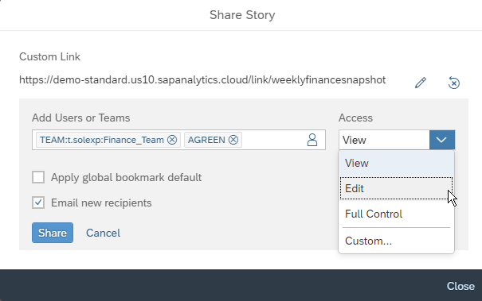



Collaboration
Increase engagement, and accountability with built in collaboration capabilities​
Commenting
Discussions
Sharing
Comment on stories, applications and event specific data point table cells. Like, reply, address other users as @UserName
Start discussions on your analytics to collaborate with other SAP Analytics Cloud users and teams, on the desktop or on your mobile device.
Easily share private or public stories and bookmarks to any
SAP Analytics Cloud user or
team via a customized link

Slide 42
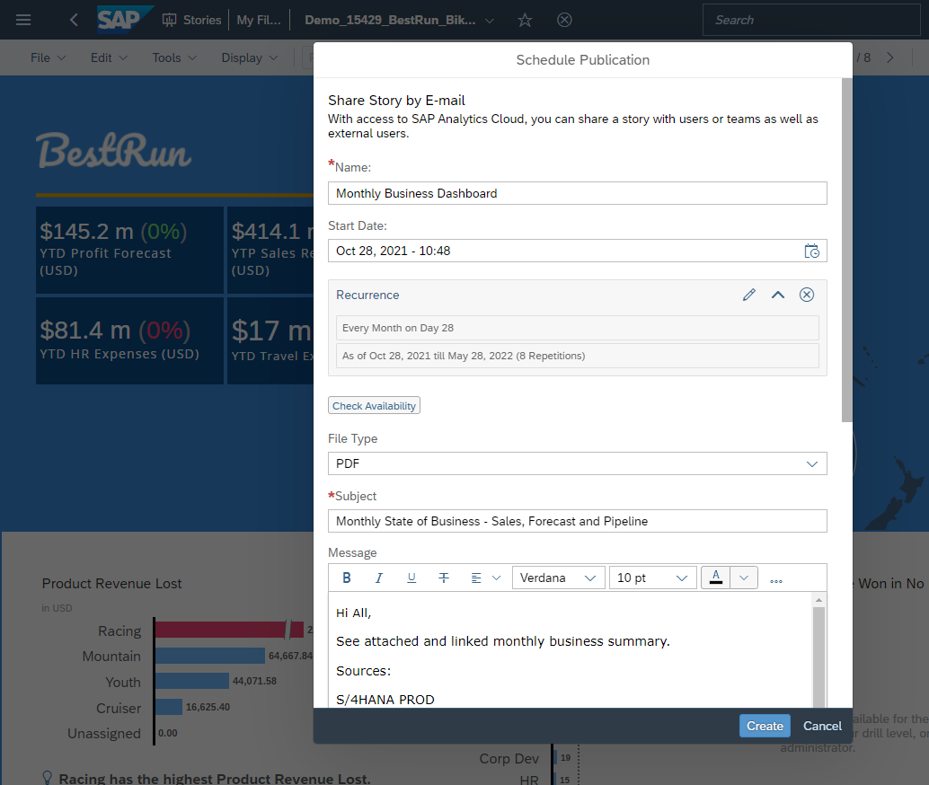
Schedule Publications
Streamline and optimize information delivery by scheduling delivery of analytics to users
  Schedule stories and analytic applications to
  SAP Analytics Cloud users, teams and non-SAP Analytics Cloud recipients
  Burst personalized content to SAP Analytics Cloud recipients based on recipient authorization
  Specify format (.pdf, .pptx or csv), prompts, variables, bookmarks, story filter and page range for schedules
  Manage schedules via calendar and configure custom SMTP server for delivery
SAP Analytics Cloud Schedule a Publication Guide
Notes:
Recurring schedule can be Weekly, Daily, Hourly
Admin
Delete unwanted schedule created by other users
Discontinue certain schedules that are not required anymore
Change time of the schedules
Scheduling content with live connection
Note that you will need to enable the “Allow live data to leave my network” System > Datasource > Configuration if you wish to schedule content based on live connection because the data is needed by SAC in order for it to be rendered for scheduling.
The maximum mail delivery size allowed per email including attachment is 12Mb
Check the FAQ for more details

Slide 43
User Experience

Slide 44
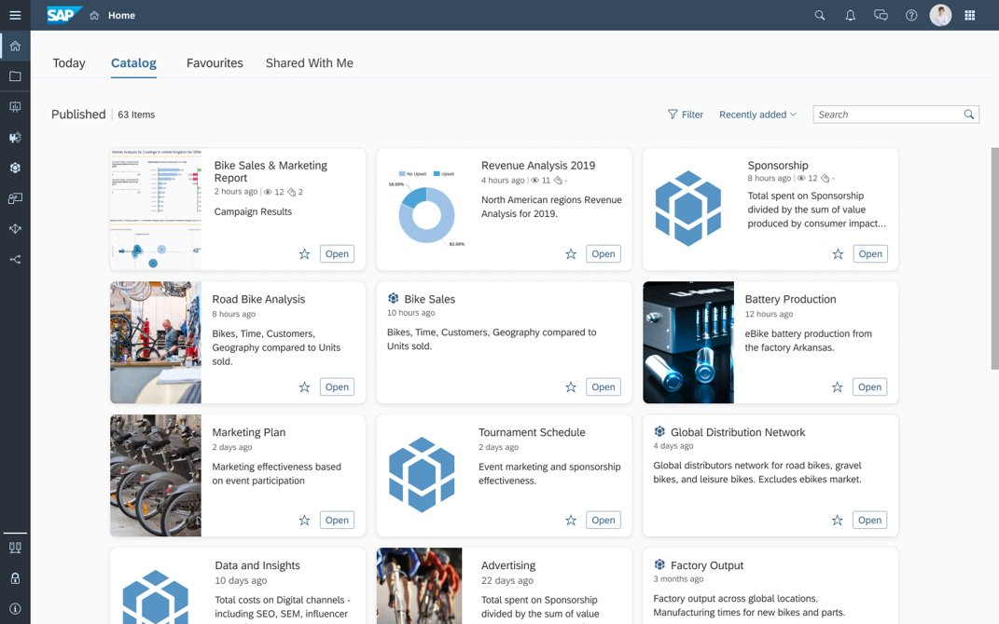
Analytics Catalog
Increase productivity and raise
user adoption of key analytics by simplifying access to analytics
  Centralize access to all analytics
  across your organization
  All analytics including SAP, non-SAP,
  cloud or on-premise can be added to Analytics Catalog
  Display analytics with consistent
  business & technical metadata
  Included in all SAP Analytics
  Cloud licenses
  Available on iOS and Android
  mobile apps
Analytics Catalog
Notes:
The challenge business users face in many organizations is finding the right report or analytics they need to accomplish their task.
Analytics Catalog addresses this challenge by centralizing access to all analytics across your organization, making it easier for users to simply search and find the analytics that they are looking for.
The administrator for the SAC tenant needs to first turn this feature on in order for it to show up on their home page.

Slide 45

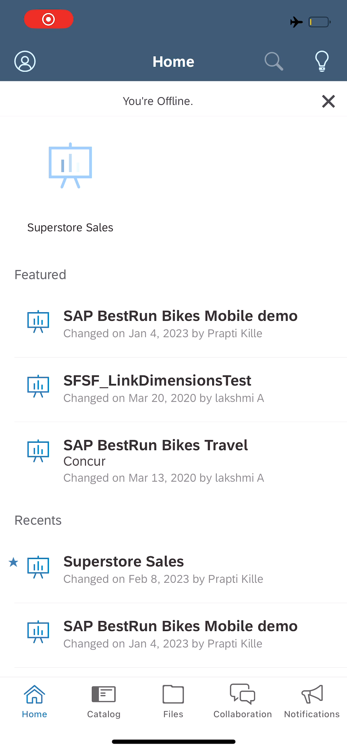
SAP Analytics Cloud Mobile
  Stay informed and connected to your analytics, any time, any place with SAP Analytics Cloud Mobile App
  View your analytics from your iOS and Android devices
  Build stories with responsive layout and preview from desktop or view from mobile app
  Intuitive mobile experience allows you to interact with your content with ease
  Supports single sign-on for easy access to analytics on mobile app
  Collaborate using discussions and access story share notifications on mobile app
Notes:
No need to design for screen size, responsive layout dynamically auto adjusts visualizations to fit any screen size

Slide 46
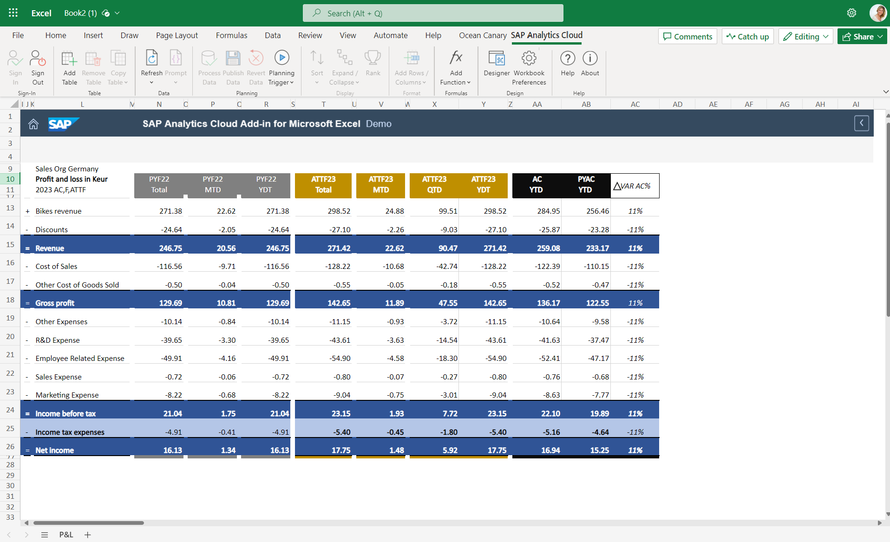
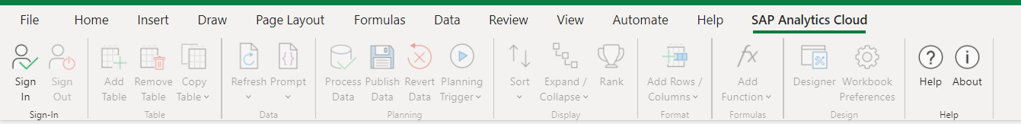
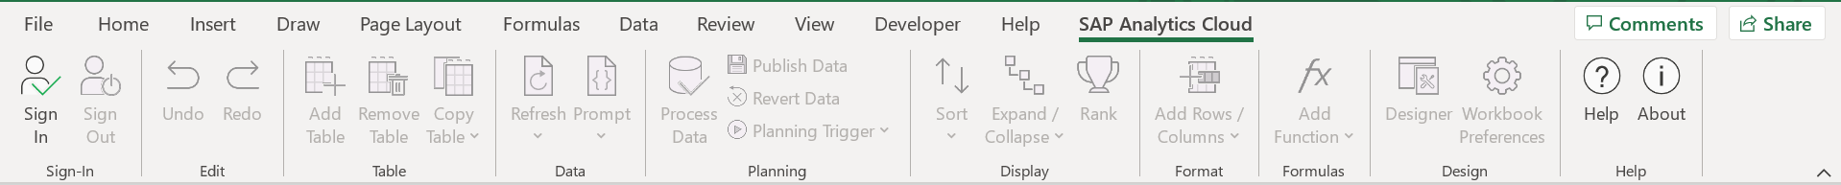
Add-in for Microsoft Excel
  Analyze your plans, simulate future outcomes, and make effective business actions with Microsoft Office Excel 365*
  Design formatted reports in Excel
  Analyze, Share or Plan against SAC native models and offers Analytical capabilities on top of live SAP BW, S/4 Hana Cloud or SAP Datasphere**
  Collaborate with colleagues online, on desktop, Windows or Mac
*Office 2021 is also supported
**More live sources–See Road Map Explorer & Blog
Notes:
This year we’ve released SAP Analytics Cloud (SAC), Add-In for Microsoft Office. We developed this new add-in for MS Office to stay in sync with Microsoft’s development of the Office 365 suite but rest assured that SAP will continue SAP Analysis for MS Office as it is still the recommend replacement for BEx analyzer and we no plans to discontinue it.
You can analyze SAP Analytics Cloud Analytic and Planning models based on Import Data connections. For planning, you can also add data for planning and save it back to the cloud.
You can analyze SAP Analytics Cloud Analytic and Planning models based on Import Data connections. For planning, you can also add data for planning and save it back to the cloud.
You can add one or several tables, each based on one model, to a workbook. Then you can add or remove dimensions and measures to analyze your data. For all dimensions and measures, you can also create a filter to specify your analysis. You can also add totals in rows and columns to your table.
In your analysis, you can use dimensions with hierarchies applied. You can expand and collapse the hierarchy nodes within the table.
During your analysis and planning, you can update your table with the actual data from SAP Analytics Cloud at any time.
Why would you use this instead of Analysis for Office?
You can use this in your browser, on desktop, windows or Mac

Slide 47
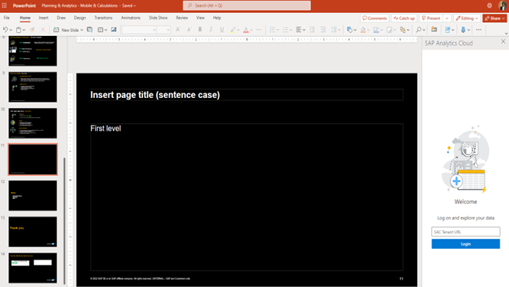
Add-in for Microsoft PowerPoint
  Intuitively add accurate and trusted data to your PowerPoint presentations, reusing your existing SAP Analytics Cloud widgets
  Intuitively connect to an SAP Analytics Cloud tenant
  Readily find SAP Analytics Cloud stories and associated widgets
  Select a widget and filter its data, if necessary
  Add the widget to the slides
  Refresh the widget's data on demand
Note: GA is currently planned for Q3 2024.
This the current state of planning and may be changed by SAP at any time.

Slide 48
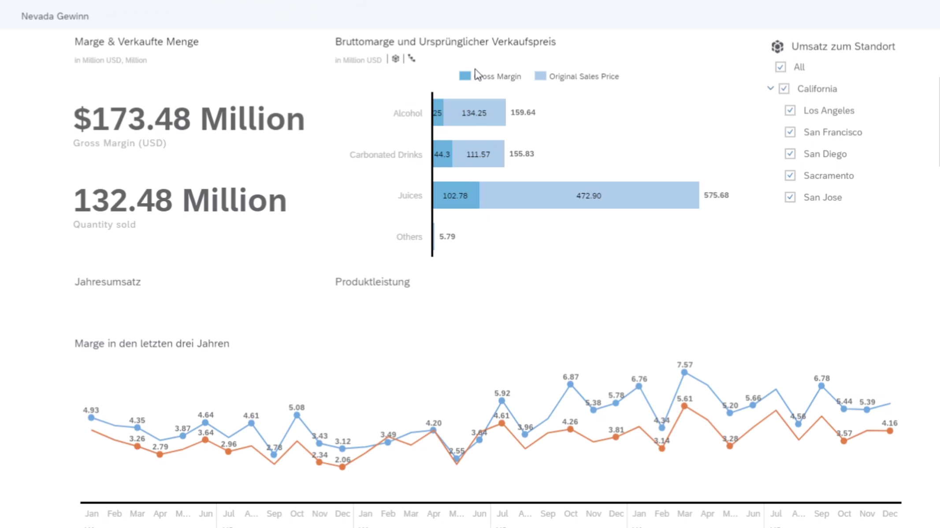


Content Translation
  Deliver the same analytics to all users across your organization, in multiple languages
  Export story and application strings to XML (.xlf) for translation and then re-import to apply translations to content
  You can translate manually by entering text in different languages
  Translate model dimensions for acquired data
Blog
Notes:
Allow translation of content needs to be toggled on in the System Configuration panel
Then translation menu on the side bar in Files appears

Slide 49
Data Connectivity

Slide 50
Data center locations – Public Cloud
Data center location
for SAP Analytics Cloud
CF-CH20
CF-EU20 (Netherlands)
CF-CA10 (Montreal)
CF-EU30 (Frankfurt)
CF-EU10/11 (Frankfurt)
CF-US20 (Washington)
CF- US30 (Iowa)
CF-US10 (N.Virginia)
CF-AP12 (South Korea)
CF-AP30
AWS GovCloud
CF-IS30
CF-JP10 (Tokyo)
CF-SA30
CF-CN40 (Shanghai)
CF-IN30 (Mumbai)
CF-AP11 (Singapore)
CF-BR30
Amazon Web Services
CF-BR10 (Sao Paulo)
Azure
CF-AP30
CF-AP10 (Sydney)
Ali Cloud
Google Cloud Platform
Planned Region

Slide 51

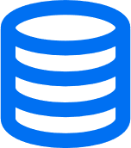



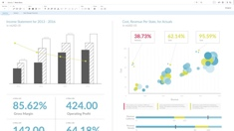
SAP Analytics Cloud Data Connectivity
  Live Data Connectivity
  Data is never replicated to cloud – real-time data is streamed directly to client machine
  Leverages source system's existing business metadata and data authorizations
  Acquired (Imported) Data Connectivity
  Data is imported into SAP Analytics Cloud
  Users can prepare, wrangle and model data
  Data is refreshed on demand or via schedule
Public
Internet
Cloud Sources
Public
Internet
Cloud Sources
Metadata
Metadata
Data
Live Data
Corporate
Network
Corporate
Network
Client desktop
On-Premise Sources
Client desktop
On-Premise Sources
SAP Analytics Cloud Data Connection Guide
Notes:
CORS Direct Connection with Reverse Proxy allows data to safely leave network to address mobile use cases (so mobile users can access live data from mobile without VPN’ing into corporate network to access data)
BOE 4.2 SP6, 4.2 SP7, 4.2 SP8 or 4.3
SAP Analytics Cloud universe feature support: https://help.sap.com/viewer/6be6d1fc887046f7a5e5c1aa52505e86/latest/en-US/c9632d24952543d690663afe8087f03f.html
Minimum SAP HANA 1.0 SPS12 with SAP HANA Info Access Service (InA), version 4.10.0 is required. Higher versions are supported.
Minimum SAP HANA 2.0 SP01 is required.
SAP BW 7.40 SP17+, recommended to upgrade to SAP BW 7.50 or SAP BW/4 HANA 2.0
SAP BW/4HANA 1.0 SP8+, recommended to upgrade to SAP BW/4HANA 2.0 SP4+
On-premise: SAP S/4HANA 1610 with SAP NW release 7.51 SP2.

Slide 52
Supported Data Connectivity
 | LIVE CONNECTIONS |  | ACQUIRED CONNECTIONS
 | SAP | Non-SAP | SAP | Non-SAP
On-Premise | SAP HANA SAP BW, BW/4HANA SAP S/4HANA SAP BPC Embedded SAP BI Universe (UNV, UNX, Web Intelligence docs) | Data sources through BI 4.3 , SAP HANA & SAP Datasphere SQL data sources through partner extensions | SAP HANA SAP BW, BW/4HANA SAP S/4HANA SAP ECC SAP BPC NW & MS SAP BI Universe (UNX) SAP Integrated Business Planning | SQL Data Sources Excel, CSV
Cloud | SAP HANA Cloud SAP Datasphere SAP S/4HANA Cloud SAP Marketing Cloud |  | SAP S/4HANA Cloud SAP Business ByDesign SAP Marketing Cloud SAP Cloud for Customer SAP SuccessFactors SAP SuccessFactors WFA SAP Fieldglass SAP Concur SAP Qualtrics | Google Drive, Google Sheet Google BigQuery OData SCP Open Connectors – MS OneDrive – Amazon S3 – MS Dynamics CRM + more
Check here for full list and supported versions
Notes:
Live connection to SQL data sources native coming next year

Slide 53
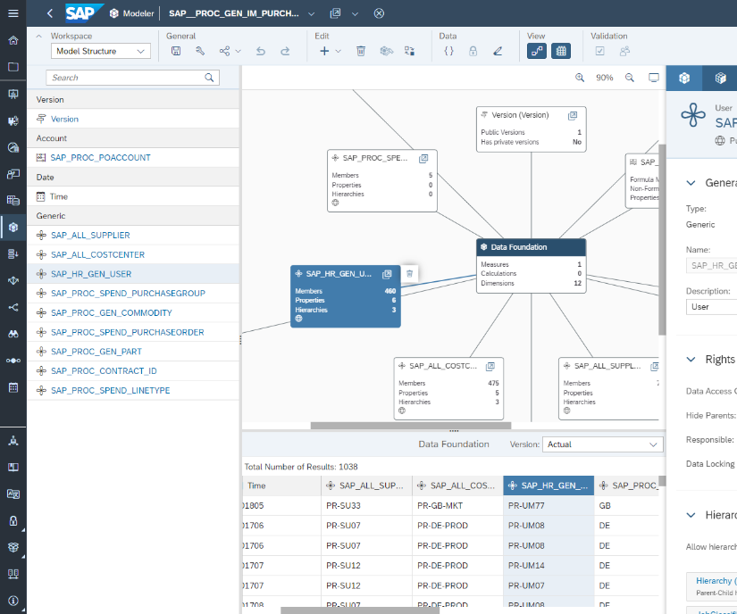
Data Modeling
  Model your imported data and define dimensions, measures, hierarchies and more, in preparation for analysis and planning
  Define your measures and dimensions, hierarchies, setting units and currencies,
  and formulas
  Enable Model Data Privacy to define row
  and column level data security
  View related objects where model is in use, such as planning work flows, stories and applications
Notes:
Note that Live data models leverage semantics and hierarchies from live source system so full data modeling capabilities is only available for acquired data models.

Slide 54

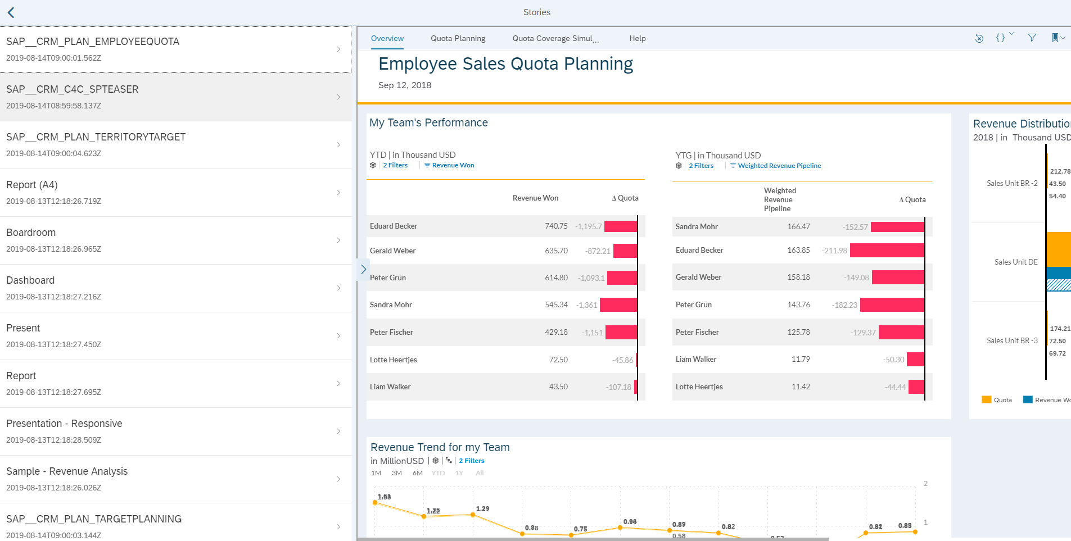


Developer APIs and SDKs
  Embed SAP Analytics Cloud stories and applications into 3rd party interfaces
  Enables seamless embedding of analytical capabilities into SAP and 3rd party apps
  Extends visualization library by creating new ones using the custom widget SDK
  Multiple SDKs and APIs available for admin and integration
Story API. Provides catalog of Stories
URL API. Renders existing stories into browser, allows for embedding stories in an IFrame
Your Application
e.g. Java or SAPUI5
Business User
Notes:
Content embedding URL API
Embed a story into a web application
Apply a story-level filter dynamically when using the URL API
Specify a model, dimension, and value to filter
Support non-default hierarchy filtering
Support HANA and BW variables and input parameters
Deep linking to a story in Analytics Cloud mobile app
Set window height and width using post message API
Story REST API
REST API returns a list of stories and story metadata
Copy, delete and rename stories
User and team management REST APIs
Create, delete, update users and teams
Content embedding URL API
Embed Analytics Designer content and provide a POST message JavaScript API for enabling Insight to Action scenarios
User and team management REST APIs
Support user profile management e.g. date formatting, data access language, preferred language
Support assigning roles which utilize concurrent session licenses
Content permission API
Allows sharing of stories between users and teams
Tenant configuration API for Hyperscalers (AWS)
OAuth Client, Live connections
Trusted Origin, Set up Customer Identity Provider, Trusted IDP
Content deployment management APIs for Hyperscalers (AWS)
API to deploy content packages to tenants
Tenant Provisioning API
Create and manage SAP Analytics Cloud tenants for embedding analytical capabilities into application built and deployed in SAP Cloud Platform
Tenant configuration API
Live connectivity to HANA, SCP
URL API
Open Application in the browser
ACN API

Slide 55
Maximize the Value of All Your Data
SAP Analytics Cloud & SAP Datasphere

Slide 56



SAP Analytics Cloud and SAP Datasphere integration journey
SAP Analytics Cloud launched in 2015
Enriched BI features
for the Analytic Model
Search & Pagination
while model browsing
Cross Calculations
Image in table cells
SAP Analytics Cloud
2015
Analytics live integration on top of Datasphere
2020
2022
2023
2024+
SAP Datasphere
Seamless integration with the Analytic Model in Datasphere
Datasphere as the one common data foundation with planning integration
Delta data export for SAP Analytics Cloud
Data Catalog
Excel 365 support for Datasphere
Enhanced planning integration with reduced data replication
Scheduling stories on
SAP Datasphere models
Data Analyzer Support for
SAP Datasphere
Lift remaining SAP Datasphere feature Limitations
2019
SAP Datasphere launched as SAP Data Warehouse Cloud in 2019
This is the current state of planning and may be changed by SAP at any time.

Slide 57




Key resources and links
SAP Analytics Cloud
Learn more about features
and functionalities of SAP
Analytics Cloud.
Join the SAP community
Join our community of SAP solution experts and customers around the world to share your experiences and get answers to your questions.
Explore our Roadmap
Gain an up-to-date overview on planned and available innovations, as well as technical information, through an interactive road map experience.
Experience for free
Experience the core capabilities and functionalities of SAP Analytics Cloud for free.
Release Highlights
Explore new features, functions, and highlights in the latest release of SAP Analytics Cloud.

Slide 58


Key resources and links
SAP Analytics Cloud
Learn more about features and functionalities of SAP Analytics Cloud.
Join the SAP community
Join our community of SAP solution experts and customers around the world to share your experiences and get answers to your questions.
Explore our Roadmap
Gain an up-to-date overview on planned and available innovations, as well as technical information, through an interactive road map experience.
Experience for free
Experience the core capabilities and functionalities of SAP Analytics Cloud for free.
Release Highlights
Explore new features, functions, and highlights in the latest release of SAP Analytics Cloud.

Slide 59
Thank you.

