Slide 1
Intelligent Warehouse optimization with SAP Warehouse Insights

Slide 2
Content
Solution Strategy
Value Proposition
SAP Warehouse Insights Overview
Roadmap

Slide 3
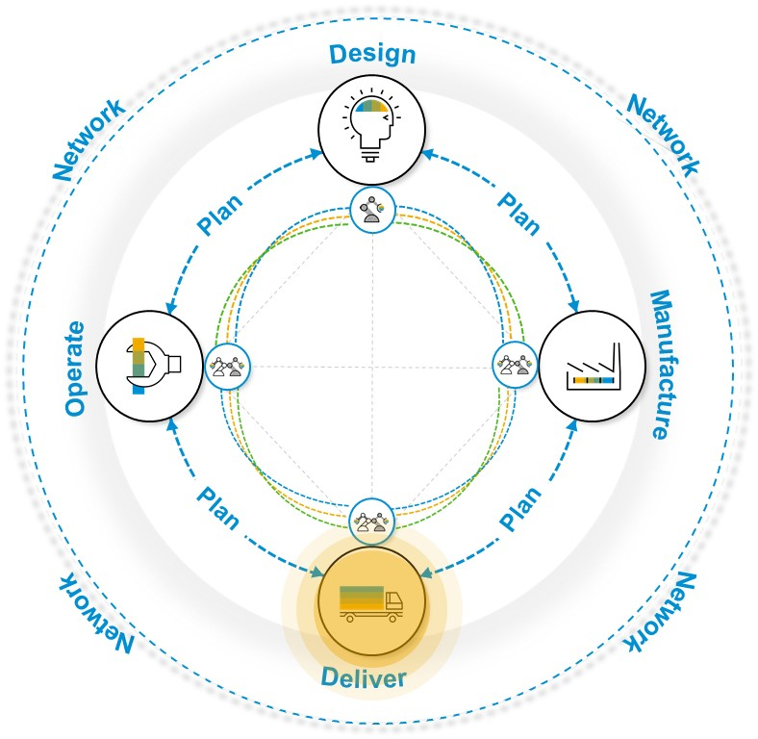
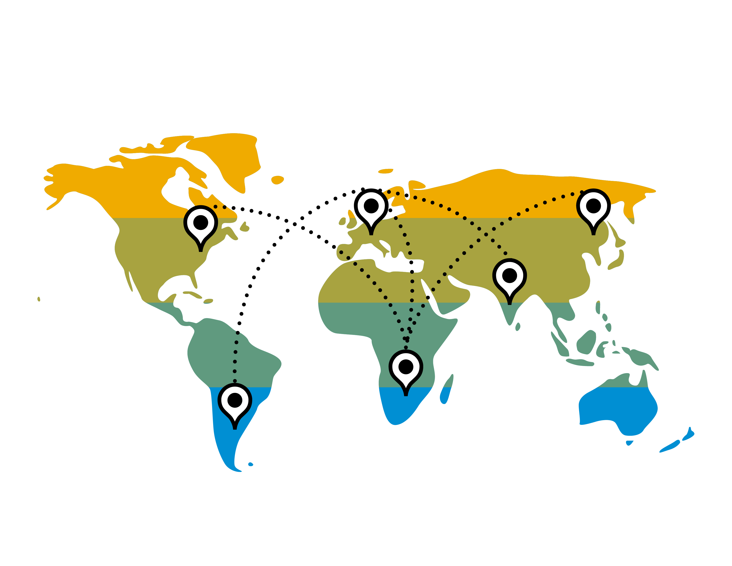
SAP Digital Supply Chain Solutions for Deliver
Enables just-in-time consumption creating the product experience by making delivery part of the promise
Digital Logistics Real-time Data
SAP S/4 HANA Advanced Available-to-Promise
SAP S/4 HANA Extended Warehouse Management & Yard Logistics
SAP S/4 HANA Transportation Management
SAP Logistics Business Network
SAP Warehouse Insights
SAP S/4HANA Cloud

Slide 4
Warehouse Insights supports intelligent Warehousing through four key pillars
Optimization
Integration
Optimize the warehouse operation real time
Easily integrate with extended warehouse management system
Analytics
Visualization
Deliver instant insight into the hands of the business
Better view of warehouse layout and improve travel network design
Notes:
The path forward
So what is the path forward? How do organizations proceed to reimagine and transform Warehousing Solutions in Cloud?
Let‘s take a look at this problem from 4 different perspectives:
Integration: How can organizations integrate their On-premise WMS system with WMS functionalities in Cloud?
Optimization: How to optimize the warehouse orders to reduce the empty travel time of the warehouse workers ?
Visualization: How can enterprise provide continuous insight into Warehouse networks and heatmaps ?
Analytics: How can the Warehouse system deliver instant insight to the hands of the business

Slide 5
Key Challenges in Warehouses
Business Needs:
Optimized task assignment
Better usage of warehouse resources
Fewer resources, more tasks executed
Better view of warehouse layout and travel network design
Solution Provided - SAP Warehouse Insights:
With optimized task/resource assignment, substantial percentage of empty travel will be saved for resources such as forklifts
Costs will be lowered as resources are used more efficiently
The optimization algorithm improves the on-time fulfillment ratio of warehouse tasks for improved customer service
Typical results
Organizations adopting warehouse Insights experiences benefits such as:
12%
Resource capacity improvement
More orders shipped on time
Efficient Labor Allocation
Reduced Labor Expenses

Slide 6
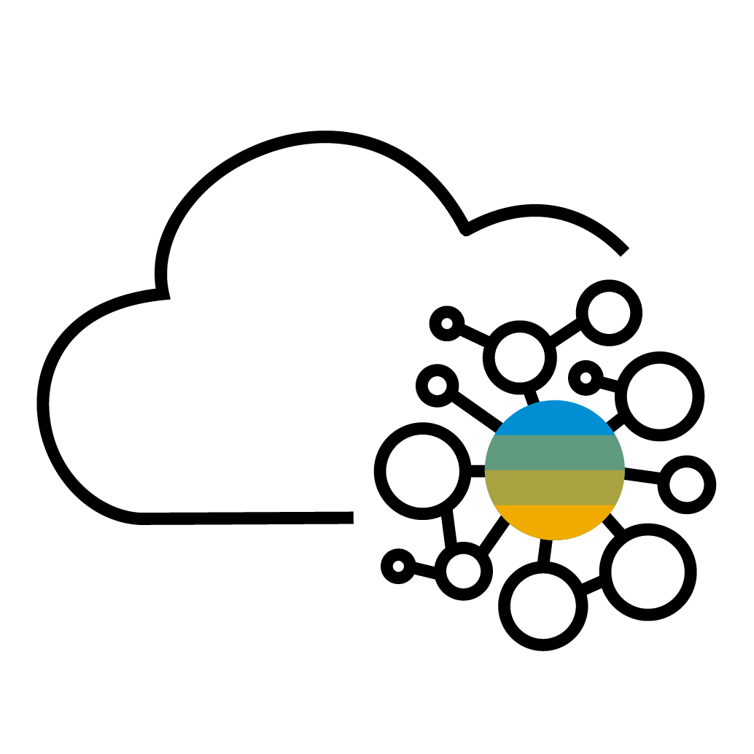
Transforming the Warehousing function With SAP Warehouse Insights
Perform layout based analysis (heatmap, resource monitoring, travel path analysis)
Provide role-based access, improve productivity
Warehouse Insights
Optimization
Visualization
Integration
Analytics
Connectivity & Platform
Simulation Services and algorithm based insights
Robust, scalable cloud service with global coverage
Leverage cloud for speed and flexibility
Real-time
insights
Back-end System
integration
360º analytical views
6

Slide 7
Transforming the Warehousing function With Warehouse Insight
Business drivers to extend
For IT
For Business
Security Compliance
Securely extend warehouse solution with side-by-side approach to keep the WMS system clean and reduce upgrade costs
Simplicity and consistency
The app is extremely easy to learn and use, and ensures error-free, consistent processes by guiding warehouse employees through their tasks step by step.
Warehouse Insights
Speed to Value
Decouple from core system enables faster deployment
Quickly consume emerging technologies for faster business outcomes
Easy to Configure
Allows customers and partners to customize solutions quickly
Out-of-the-box integration with the EWM in SAP S/4HANA and SAP EWM in business suite
Best in class UX with consistent experience across the Solution
Maximize order optimization and accuracy for competitive advantage with business processes innovations
Improve customer satisfaction by embedding intelligence across processes

Slide 8
SAP Warehouse Insights Innovations 2019
Available
WI 1911
Available
WI 2003
Optimization Simulation
Visualized and Interactive Warehouse Layout
Warehouse data Upload
based on historical transaction data with advanced algorithms
Get Your Warehouse data Imported
Analytics and KPI dashboard
Realtime Optimization
Based on Warehouse Order
Heatmap
1911
Initial Cloud Release
Fiori App
Fiori App
Travel distance Network
Fiori App
Manage warehouse
Fiori App
Define bin coordinates for racks in straight isles
Define Integration Setting
Warehouse Operation Overview
Fiori App Define Bin Coordinate
Fiori App
Warehouse Layout

Slide 9
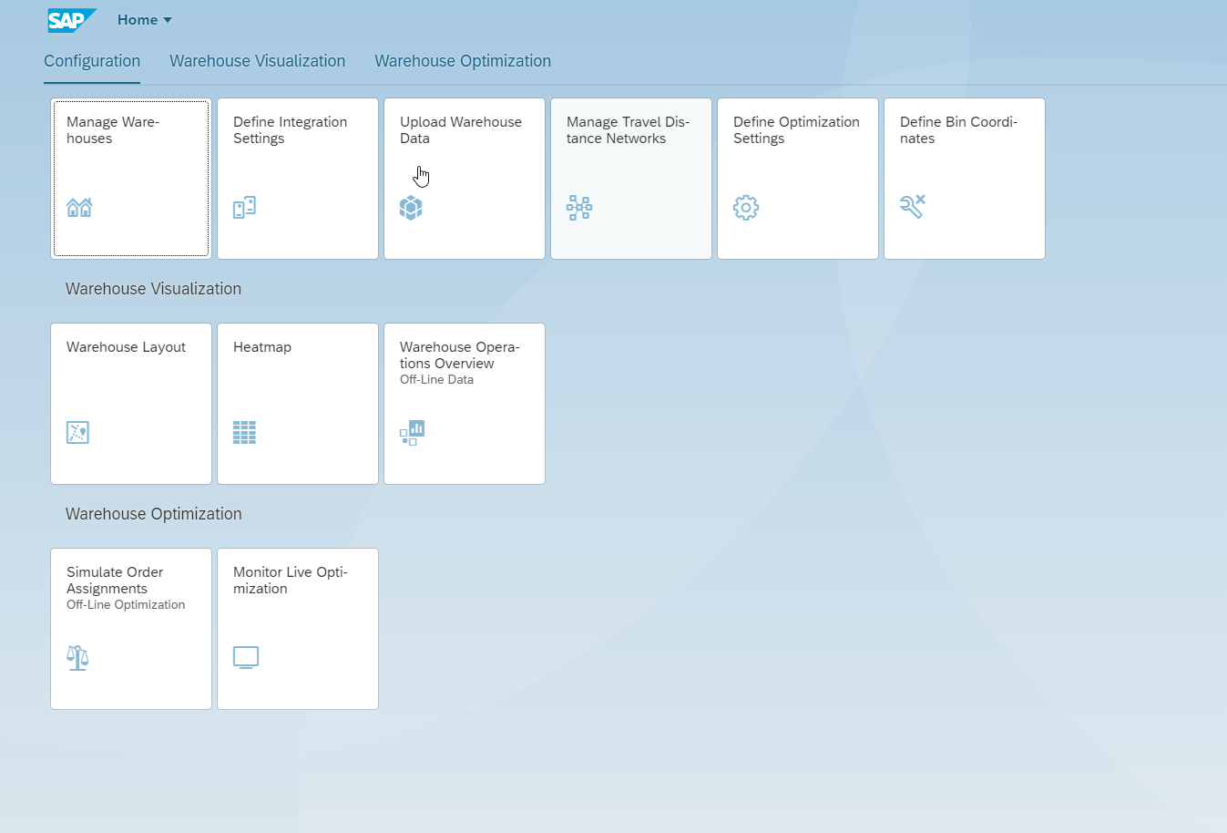
Roles, Apps and Tiles
Transactional Apps
Setup Apps
Define Bin Coordinates
Warehouse Clerk
Warehouse Layout
Warehouse Operation Overview
Monitor Live Optimizations
Simulate Order Assignments
Heat Map
Configuration Expert
Define Optimization Settings
Manage Warehouse
Define Integration Settings
Manage Travel distance Networks
Upload Warehouse Data

Slide 10
Integration System Approach
Solution Highlights
Integration with SAP Extended Warehouse Management and EWM in SAP S/4HANA
Able to integrate SAP Warehouse Insights with the following versions of SAP EWM or EWM:
SAP S/4HANA 1909 (FPS01 or higher)
SAP S/4HANA 1809 (SP03 or higher)
SAP EWM 9.5 (SP05 or higher)
SAP EWM 9.4 (SP11 or higher)
Cloud
SAP EWM
Master Data
Commercialization
Analytics
SAP Warehouse Insights
Data Management
Integration
Security
Business Benefits
Easily Migrate data and integrate with WMS systems
Simple and secure Integration of systems
On the best cloud infrastructure around the world
SAP Cloud Platform Foundation
* This is the current state of planning and may be changed by SAP at any time without notice.
Notes:
SAP Cloud Platform provides everything that you need to accelerate the Intelligent Enterprise, from pre-built applications and open APIs to the critical business and technical services that you need to build capabilities and applications quickly. It’s innovative, cloud-native, and open. And it runs on the best cloud infrastructure around the world, on all of your favorite clouds.
Upload Warehouse Data
With this app, you can upload essential warehouse data for optimization processes and analysis.
Prerequisites
Make sure that you have performed the following actions:You have created a warehouse number using the Manage Warehouses app.
If you want to upload confirmed warehouse orders and warehouse tasks from a destination system, make sure that you have connected to a destination system and destination warehouse number using the Define Integration Settings app.
You have downloaded CSV files from the destination system, for example, SAP EWM. To download these files from SAP EWM, implement the SAP Note 2722858 .

Slide 11
Integration Landscape Approach
SAP Warehouse Insights
From SAP EWM: Warehouse Layout / Active Resources /Open Warehouse Orders/ etc.
SAP Cloud Connector
SAP EWM
S/4 HANA EWM
EWM data
WI result
To SAP EWM: Optimized Warehouse Order assignment
LIVE Optimization
The Cloud Connector
Serves as a link between SAP Cloud Platform applications and on-premise systems.
No need to configure the on-premise firewall to allow external access from SAP Warehouse Insights to internal systems
Recovers broken connections automatically.
Provides audit logging of inbound traffic and configuration changes.
Can be run in a high-availability setup.
Notes:
The Cloud Connector:
Serves as a link between SAP Cloud Platform applications and on-premise systems.
Combines an easy setup with a clear configuration of the systems that are exposed to the SAP Cloud Platform.
Lets you use existing on-premise assets without exposing the entire internal landscape.
Runs as on-premise agent in a secured network.
Acts as a reverse invoke proxy between the on-premise network and SAP Cloud Platform.
Provides fine-grained control over:
On-premise systems and resources that can be accessed by cloud applications.
Cloud applications using the Cloud Connector.
Lets you use the features that are required for business-critical enterprise scenarios.
Recovers broken connections automatically.
Provides audit logging of inbound traffic and configuration changes.
Can be run in a high-availability setup.

Slide 12
Roadmap – SAP Warehouse Insights
Plan only - Subject To Change
Future
Vision
IoT Integration
Optimization based Machine Learning
Open API‘s
Planned
Realtime Resource Positioning
Cross Warehouse Analysis
Robotics Integration

Slide 13
Next Steps
1
2
3
4
Discover
Discover more Application Help
What's New
Quick start guide
FAQ
Contact
Contact your account team to schedule a meeting
Contact your solution-focused SAP partner
Engage
Engage with SAP in design thinking workshops
Initiate
Kick-start your trial project in the SAP cloud
Trial
Notes:
Need to double check links

