Slide 1


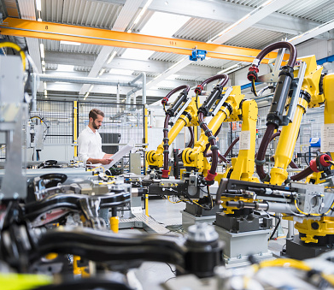
A Risk-Resilient and Sustainable Supply Chain
SAP solutions for Digital Manufacturing
SAP

Slide 2
Disruption did more than empty the shelves.
How do you reverse 20 years of globalization in 20 months?
Notes:
We’re all tired of talking about disruption, but it’s the reality we’ve lived through and are living in. And it’s important to remember that the disruption we’ve experienced did more than leave empty shelves. Entire supply chains were impacted, and businesses found themselves in jeopardy of survival. Everyone around the globe scrambled to pivot their businesses to be more agile and resilient. But they didn’t address the core issues – supply chains for the most part remain exposed to risk.
Why? Because the world has changed and most supply chains weren’t keeping up.
As we’ve all learned, it’s not easy to reverse 20 years of globalization in 20 months. It’s not easy to transform your supply chain from cost-conscious to and risk resistant and resilient.
For decades, supply chains were considered a cost center – and managing them focused on maximizing profit. For example, we focused on finding the low-cost supplier or manufacturer, which meant going off-shore. We optimized to reduce working capital and shipping costs. And then the world changed! We realized just how vulnerable our supply chains had become due to risk and disruptions. To lockdowns, port closures, canal blockages, supply shortages, no-fly zones and more. Now, supply chain management is about how to alleviate that risk. We need to rethink how we design our supply chains to design risk right out of them.

Slide 3
Reactive responses won’t fix foundational problems.
Narrowly focused improvements amplify silos and disconnections.
Historically focused data constricts decision making.
Internally focused strategies overlook critical collaboration.
Notes:
Unfortunately, the effort of the last 18 months hasn’t fixed the foundational problem.
Efforts were made to improve existing systems and processes in isolation rather than across all facets of the business. As a result, functional business areas remain disconnected and operate in silos rather than interoperable business processes.
Decisions were made in functional isolation based on “historical” analysis and static operations rather than in-the-moment, real-time information driven actions.
The ability to collaborate with critical partners in the ecosystem remains weak and open to further disruption and risk.
At the same time, sustainability initiatives have been overlooked while mandates keep looming.
Companies took reactive, short-term actions to improve efficiency, productivity, and sustainability in parts of the business where they felt they could have the most impact, but they did not build a supply chain for the long-term; one that can withstand the forces of change, whether they are physical, financial, or technology-related.

Slide 4
A risk-resilient supply chain demands a different approach:
1
Connect every process
within your supply chain and across your business.
2
Contextualize every decision
linking real-time operational and business data together throughout the work process.
3
Collaborate with your ecosystem
creating digital connections with all your partners.
Notes:
So what needs to be done? Supply chains need to evolve to take into account cost, speed, profit, customer service, and risk. We need to manage the business holistically by:
Connecting supply chains to the entire business
Contextualizing information during the work process and the relevancy of the decision
Collaborate both inside the business and across networks
With this, you get a risk resistant business to help manage or even mitigate future risks.
Let’s take a closer look at what risk-resistant supply chains can do.

Slide 5

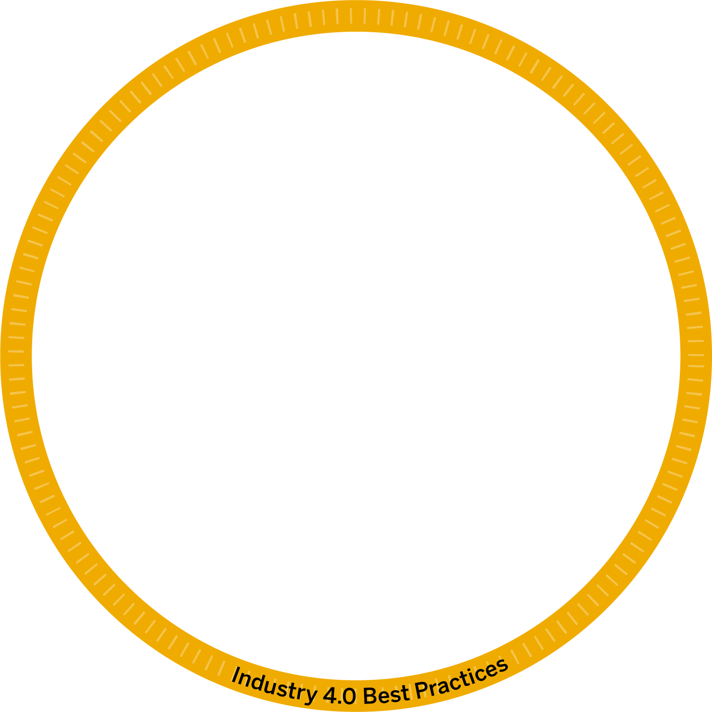













This is the unique value only SAP can offer:
1
Connect every process
2
Contextualize every decision
3
Collaborate with your ecosystem

Slide 6
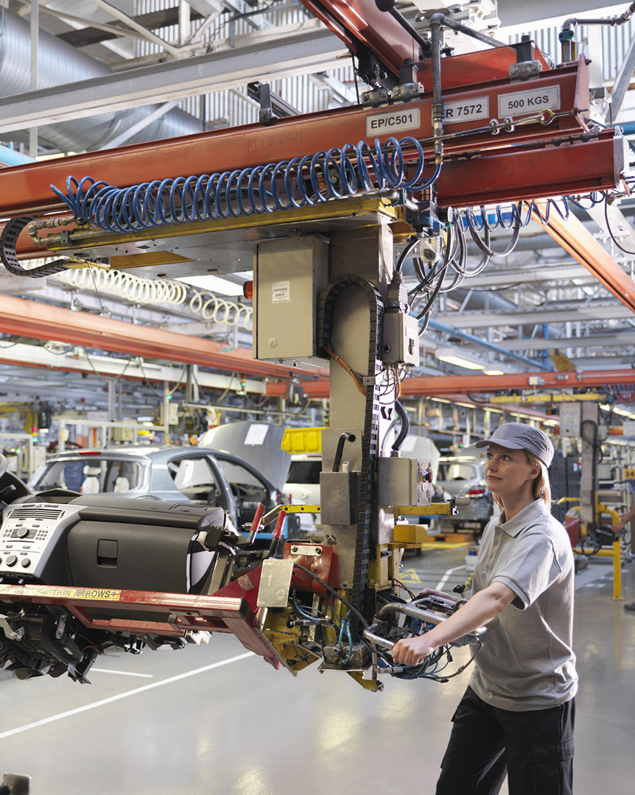
Manufacture
Connect Every Process
Imagine if you could:
  Meet demand in every market by connecting operations to supply chain sensing.
  Choose the best production mode with visibility into real-time demand and configuration requirements.
  Accelerate cycle and task time by connecting and streamlining execution processes.
  Improve availability and on-time delivery by linking output to logistics systems.
Notes:
Meet demand in a demanding market.
Connect manufacturing operations to supply chain demand sensing , so you can prepare for and manage production volatility.
Choose the mode that matters.
Improve visibility into real-time product demand and configuration requirements to determine and adapt to the best mode of production.
Accelerate cycle and task time.
Connect and streamline manufacturing execution processes to compress and continuously improve production time.
Link logistics from freight to production.
Align production output to logistics systems to ensure transportation availability and on-time product delivery.

Slide 7
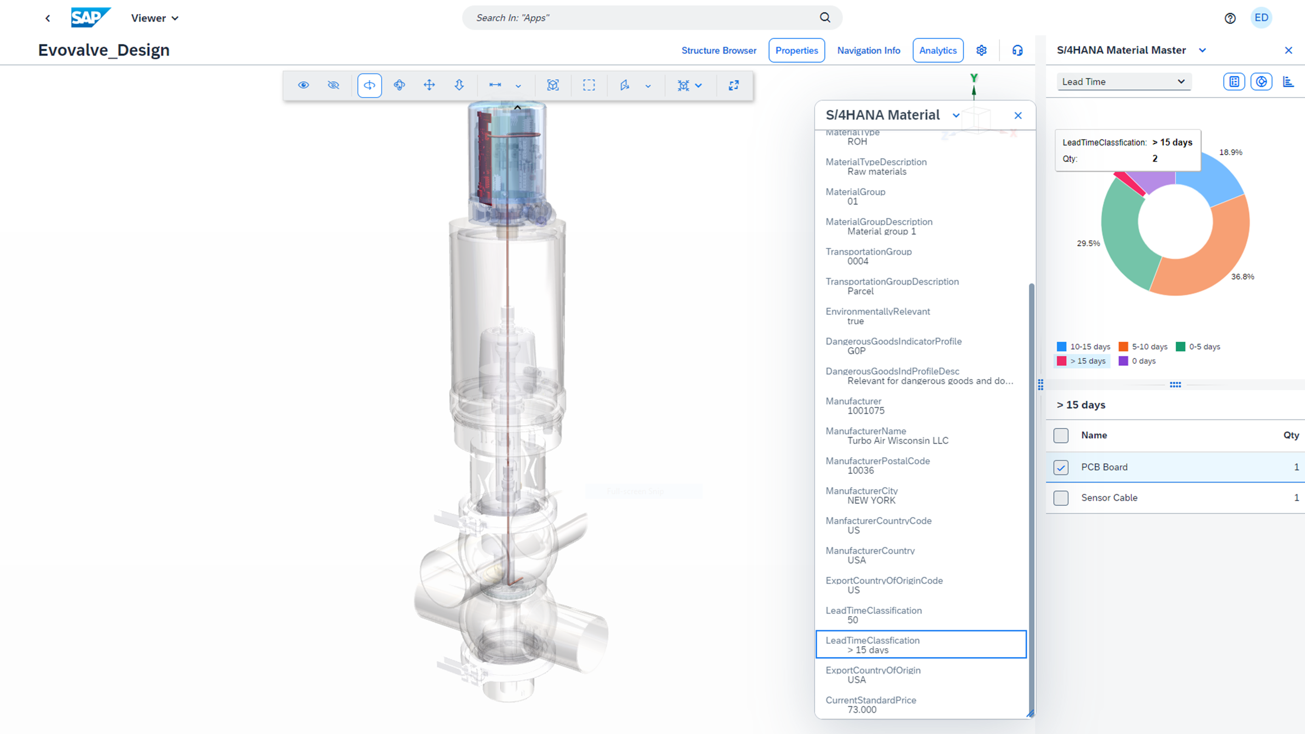
Manufacture
Contextualize Every Decision
Imagine if you could:
  Deliver insight to the decision point, by making holistic data available at the right time to the right people.
  Tailor insight to the right roles with dashboards that analyze manufacturing processes from different perspectives.
  Provide worker guidance by showing 3D details your team can use to examine specs, costs, sustainability, and more.
  Build a predictive, proactive safety culture using advanced and automated hazard identification and risk mitigation.
Notes:
Deliver insight to the decision point.
Make holistic data widely available, so your team working closest to the process has the right information they need to make the right decision for the business.
Turn measurement into improvement.
Deliver roles-based dashboards to help your team analyze manufacturing processes from their unique perspectives – so plant managers can see plant-level data, while supervisors monitor overall production and quality KPI’s
Provide worker guidance
Deliver virtual 3D models of products, assemblies, and components to your teams in the office and on the shop floor – models that allow them to drill into detail and examine everything from specs and suppliers to costs and sustainability in a simple, visual way.
Build a predictive, proactive safety culture.
Use advanced and automated hazard identification and proactive exposure
risk mitigation to get the visibility you need to reduce risks to your people, business, and the environment.

Slide 8
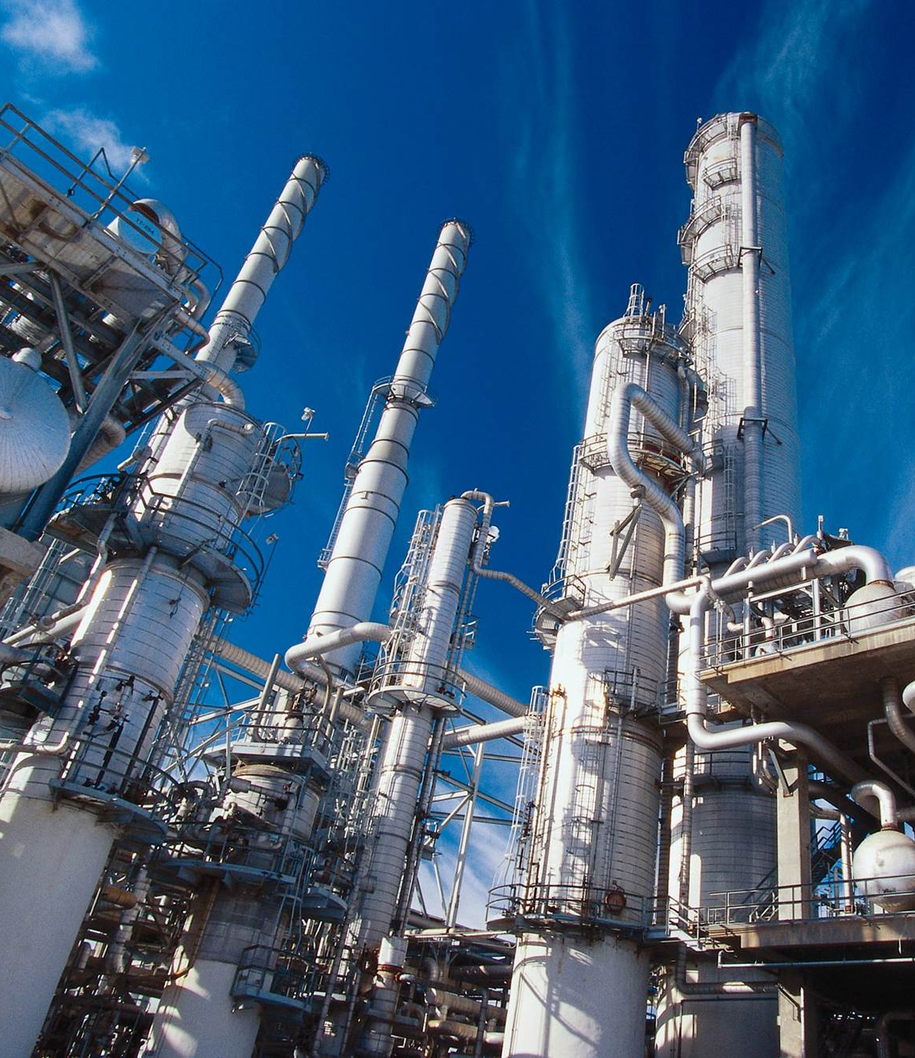
Manufacture
Collaborate with
Your Ecosystem
Imagine if you could:
  Add capacity not overhead by balancing your production resources and contract manufacturing capabilities.
  Manage service from the shop floor with visibility into asset status/health and ability to request maintenance.
  Align production and supply with transparency into availability and delivery schedules.
  Shift production on the fly using visibility, process standardization, and an infinitely scalable platform.
Notes:
Add capacity without adding overhead.
Balance internal production resources and contract manufacturing partner capabilities to provide flexible and adaptive production capacity, gaining the agility to respond to spikes in demand
Manage service from the shop floor.
Empower production workers to select an asset, view its status and health, and trigger a request for maintenance from third-party service providers.
See into each link in your supply chain.
Provide early visibility into current component availability and supply chain delivery schedules to align production with supply. And gain greater visibility into demand, planning, inventory, production cadence, and logistics.
Run better everywhere from one place.
Use visibility, process standardization, and an infinitely scalable platform to shift production to where it makes the most sense – whether that’s across the plant, across town, or across the world.

Slide 9


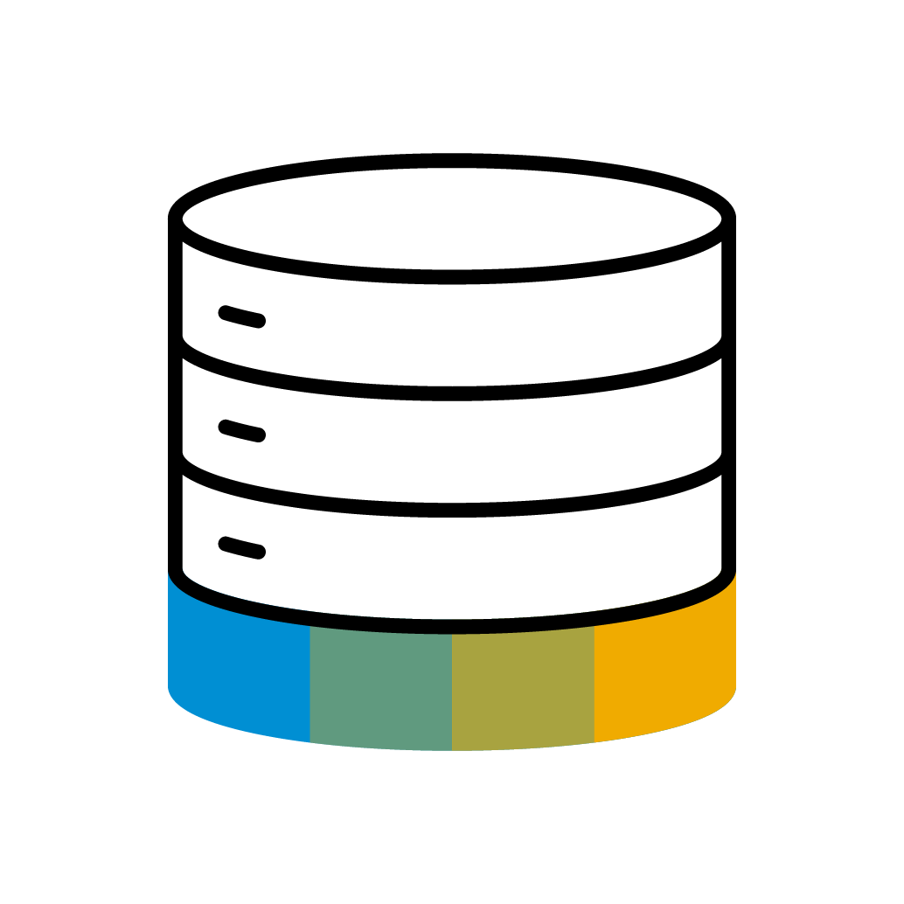
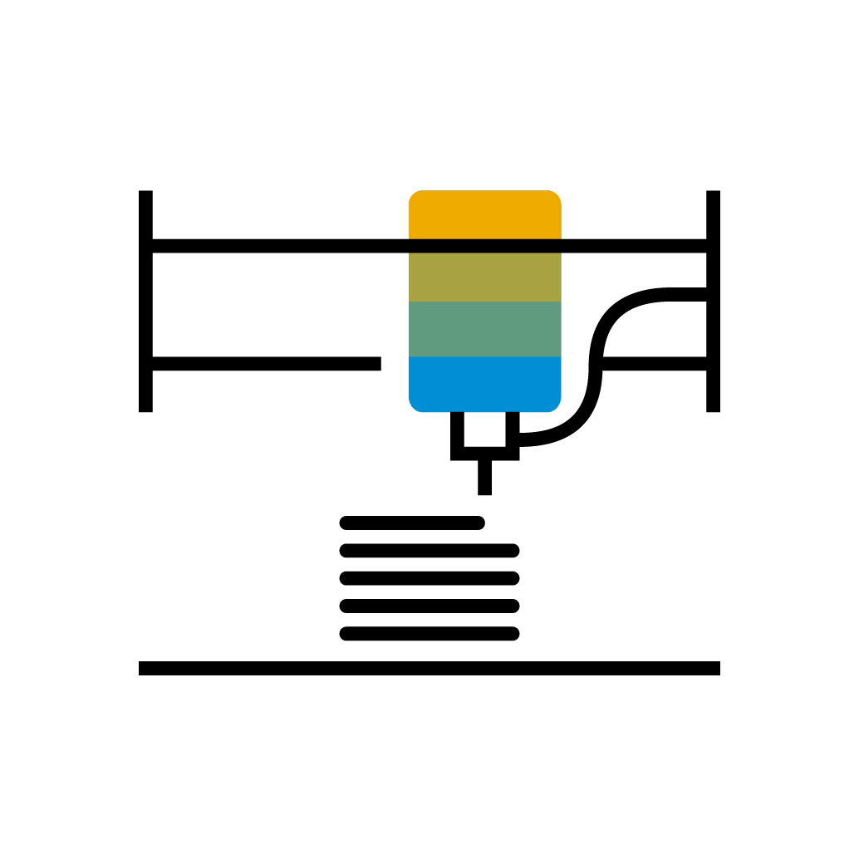

Market Drivers and Dynamics
Industry 4.0 driving competitiveness in today’s challenging environment
Cloud
Computing
Agility
Individualized
products & services
Autonomous
systems
  Speed to market
QUALITY
Technology Enablers
  Product-Portfolio Rotation
5G & Edge computing
COST
Machine
Learning
Sustainability
Efficiency
Worker Safety
DELIVERY
Increase productivity
Additive
Manufacturing
Sustainable operations
Resource Utilization
Compliance
Mixed-mode production
Augmented
Reality
2022 SAP SE or an SAP affiliate company. All rights reserved. ǀ
PUBLIC
Notes:
The manufacturing environment is changing. The focus is no longer on capacity, but, on the ability to respond quickly to customer needs and market changes while still controlling costs and quality. Until recently, supply chains were mainly measured by efficiency metrics. Today, new trends are emerging that present complex challenges and put supply chain and manufacturing at the center not only of business success but also of a company’s differentiation strategy. Companies in manufacturing industries face numerous challenges. They need to produce smarter quantities while maintaining high quality in volatile markets. Customers demand individualized products down to lot size 1. Lifecycles of products get shorter and shorter. Faster time to market is key for staying competitive. Business models change from selling products to delivering solutions.
At the same time, there is intense price and margin pressure, to become more efficient and drive productivity gains while increasing resource utilization. Beyond labor productivity and asset-efficiency, the next performance leap in factories will be through end-to-end effectiveness of production systems. Mixed-mode manufacturing is becoming the new norm where you must support both process and discrete manufacturing. Your production processes must evolve to support the future demand and customer requirements.
Optimize manufacturing processes to minimize negative environmental impacts while conserving energy and natural resources and establishing safe working conditions has become a key objective of most companies.
Employing advanced technologies like IoT, ML, and AI provides the ability to collect, process, and share (near) real-time information from machines, vehicles, and people that connects the silo’s of transactional data that helps you turn this raw data into improved business process automation and actionable insights.

Slide 10

Manufacture:
SAP solutions for
Digital Manufacturing
Execute
Automate processes and resources to improve manufacturing efficiency, quality and productivity.
SAP Digital Manufacturing for execution
SAP S/4HANA for Manufacturing Production Engineering and Operations
Analyze
Gain intelligent insights and analysis across global plant operations.
SAP Digital Manufacturing for insights
Improve
Collaborate with suppliers and other stakeholders for quality issue resolution.
SAP Quality Issue Resolution
Protect
Reduce risk with workplace safety, drive sustainable operations, and reduce your environmental impact.
SAP S/4HANA for Workplace Safety
SAP S/4HANA for Environment Management

Slide 11
Execute
Automate processes and resources to improve manufacturing efficiency, quality and productivity

Slide 12
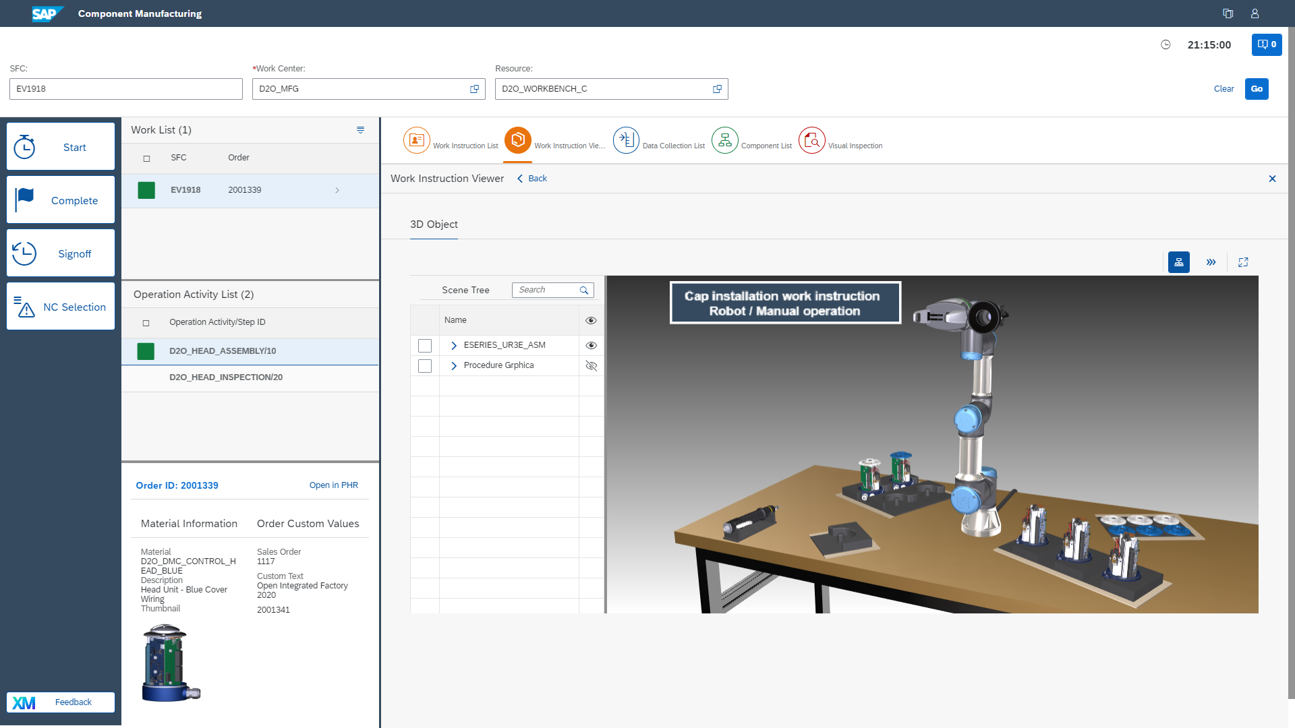
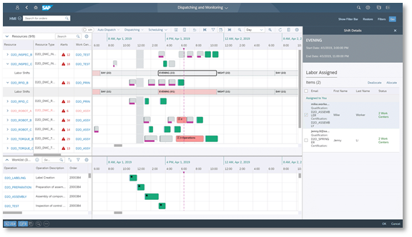
  Execute…SAP Digital Manufacturing
Improve manufacturing efficiency, quality and productivity
Lower costs and increase productivity and quality with a smart factory
Manage resource constraints and adapt to changes
Employ real-time analytics for manufacturing performance
Notes:
Paperless production with intuitive user interfaces for production operators, automatic data collection and set machine parameters, thereby lowering cost, increasing productivity and quality.
Design, distribute and dynamically control manufacturing shop floor activities enabling a smart factory.
Shift and Labor planning to match business operations with qualifications. Production Order scheduling and dispatching considering labor, resource and maintenance constraints to plan operations and adapt to short term changes.
Cross plant real-time analytics for manufacturing performance e.g. Perfect Order Fulfillment, Overall Equipment Effectiveness, loss analysis along with machine data to identify improvement opportunities.
Collect and share product genealogy data between members of the network to trace accountability and provide transparency.

Slide 13
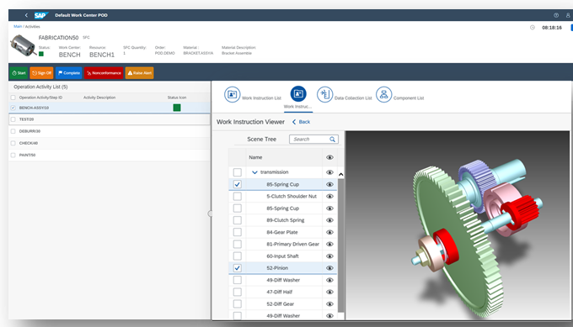
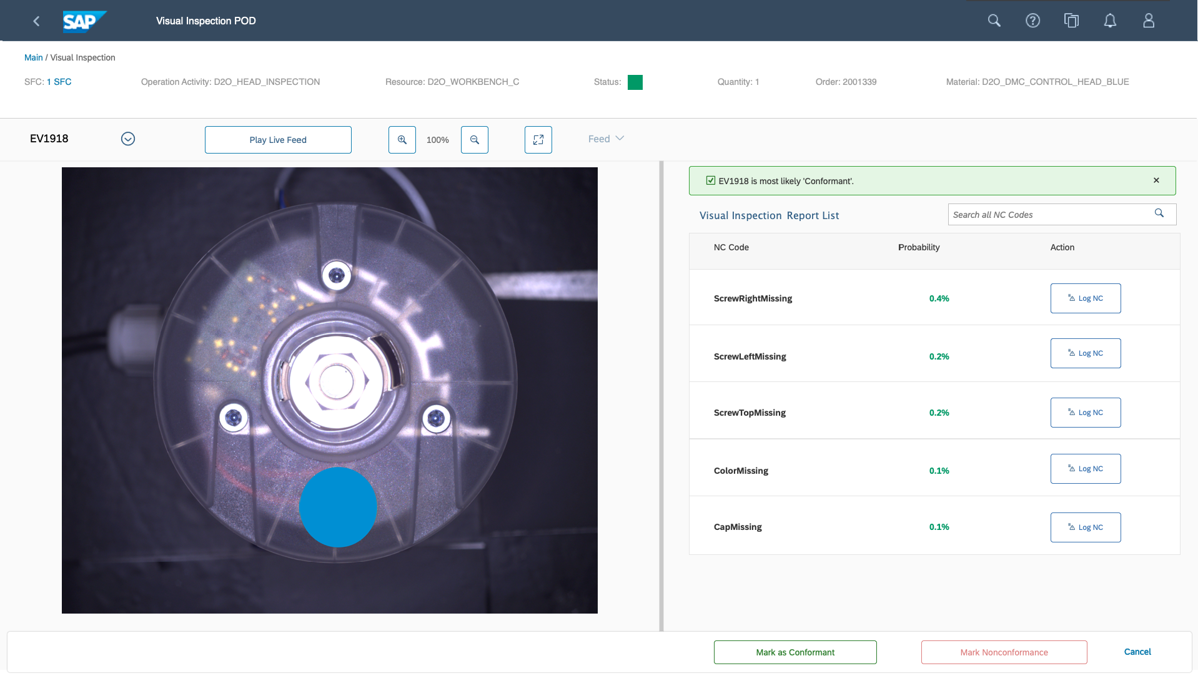
  Execute…SAP Digital Manufacturing for execution – Discrete Industry
Schedule, automate processes and resources to improve manufacturing efficiency, quality and productivity
Compress the manufacturing lifecycle
Implement top-floor to shop-floor scenarios
Agility in the face of unexpected events
Notes:
Enable resource orchestration by dispatching and sequencing operations to compress the manufacturing lifecycle and provide real-time production performance tracking
Implement top-floor to shop-floor scenarios to achieve rapid return-on-investment through out-of-the-box integration to SAP solutions
Utilize intuitive user interfaces (UI) for production operators and transform to paperless production, lowering cost and increasing productivity
React quickly to unexpected events by monitoring the entire manufacturing process to optimize resources and speed execution utilizing built-in intelligence
Machine learning models assist operator on the shop floor to execute visual inspection tasks of manufactured products

Slide 14
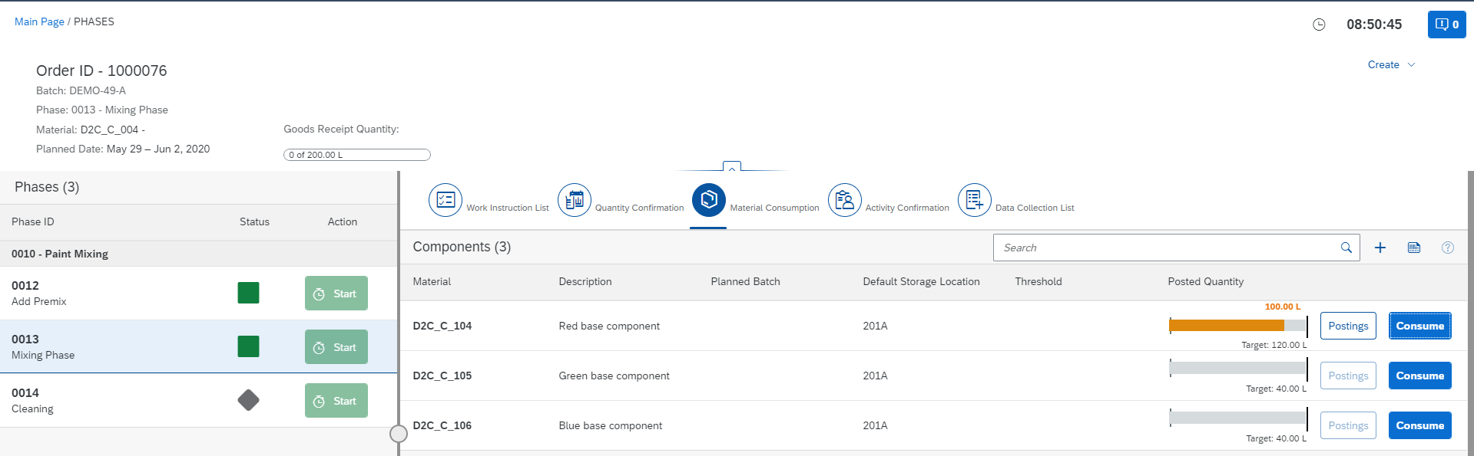
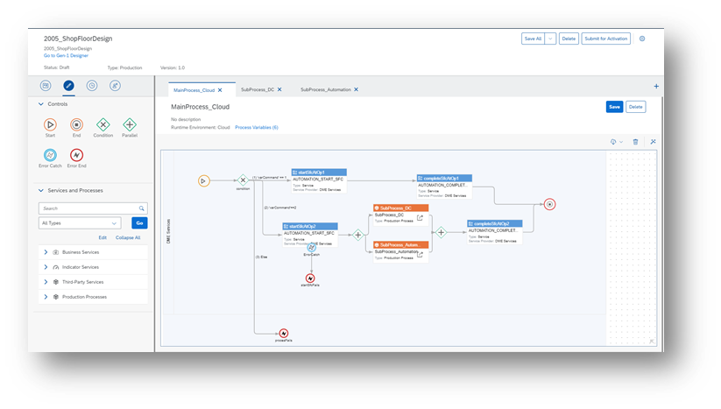
  Execute…SAP Digital Manufacturing for execution – Process Industry
Schedule, automate processes and resources to improve manufacturing efficiency, quality and productivity
Support order-based execution of process orders with single batches
Implement top-floor to shop-floor scenarios
Agility in the face of unexpected events
Notes:
Provision of the new Order POD to support order- based execution of process orders with single batches
Implement top-floor to shop-floor scenarios to achieve rapid return-on-investment through out-of-the-box integration to SAP solutions
Utilize intuitive user interfaces (UI) for production operators and transform to paperless production, lowering cost and increasing productivity
React quickly to unexpected events by monitoring the entire manufacturing process to optimize resources and speed execution utilizing built-in intelligence
Collaborative integration to allow you to respond quickly to unexpected events

Slide 15
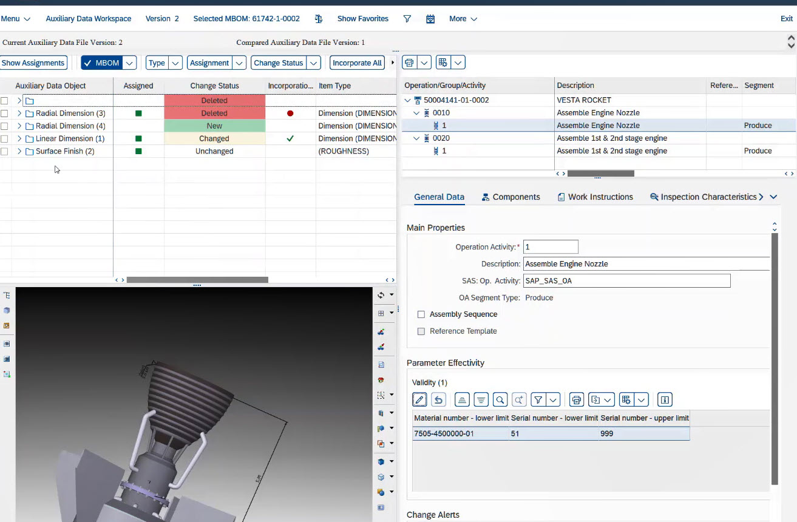
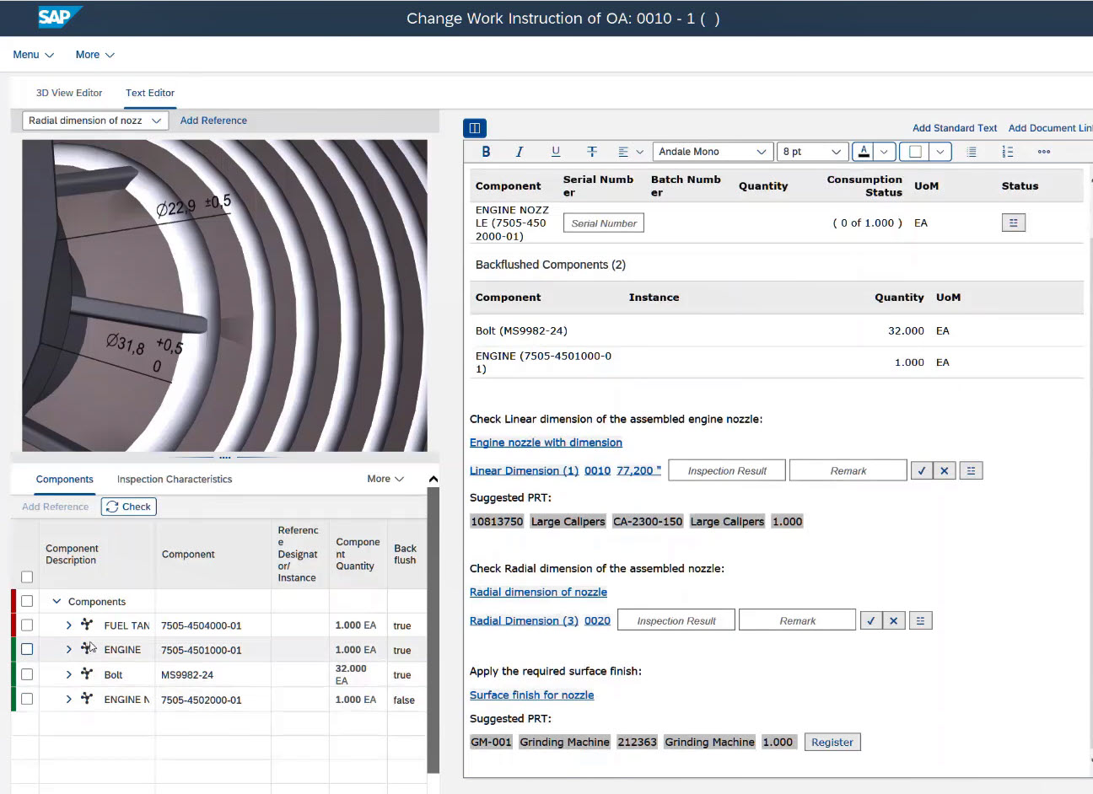
  Execute…SAP S/4HANA for Manufacturing Production Engineering and Operations
Integrate and connect engineering and manufacturing processes to meet production requirements
Enhance manufacturing collaboration
Minimize production disruption and reduce cycle time
Meet delivery expectations
Notes:
Enhanced manufacturing collaboration throughout the global enterprise leveraging latest design master data (digital twin) for consumption within production
Optimize engineering to manufacturing BOM’s and manage routings and operations with 3D visuals, work instructions, and data collection parameters to gain process efficiency
Manage and analyze the impact of change to minimize production disruption from revised routings, work instructions and production orders
Streamline manufacturing build package creation, planning and shop floor operations for global production environments to reduce cycle time
Meet delivery expectations despite updates to existing production orders triggered by engineering changes, quality issues, or product configuration changes

Slide 16
Analyze
Gain intelligent insights and analysis across global plant operations

Slide 17
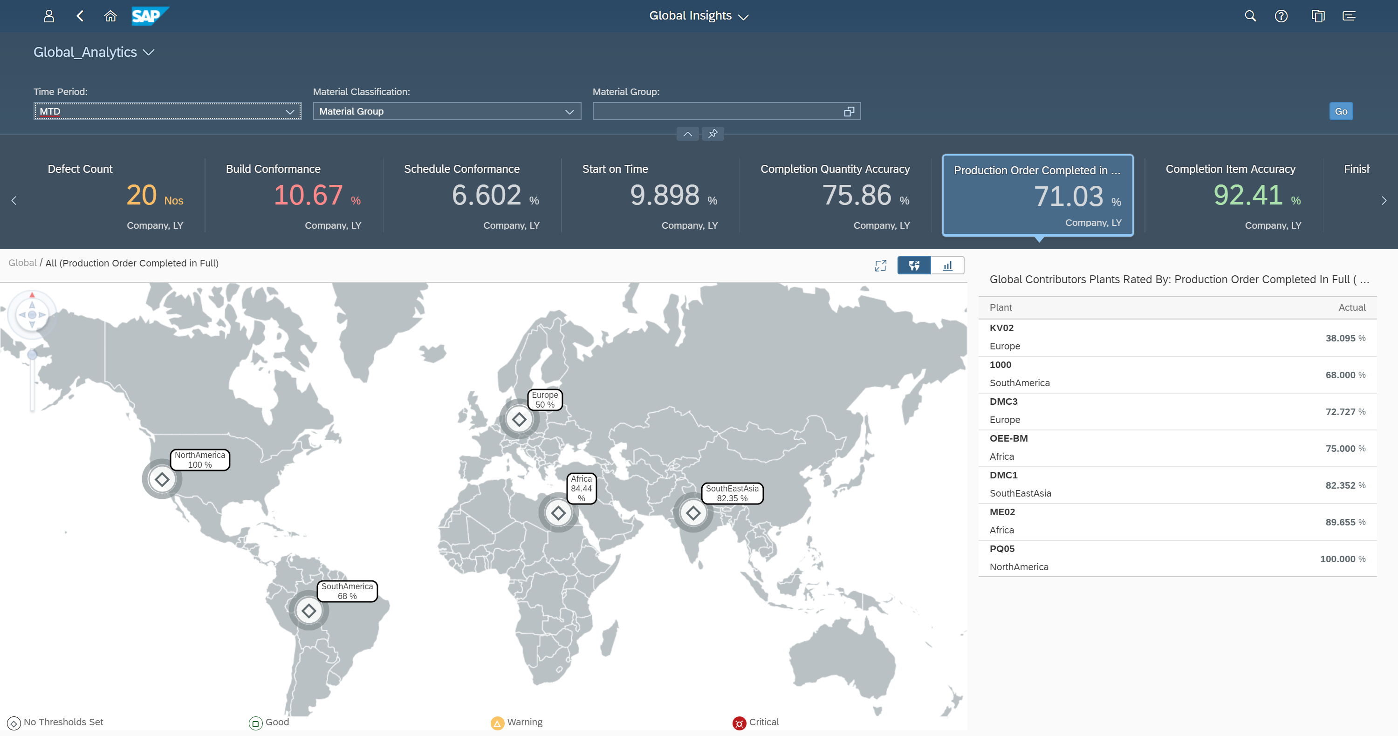
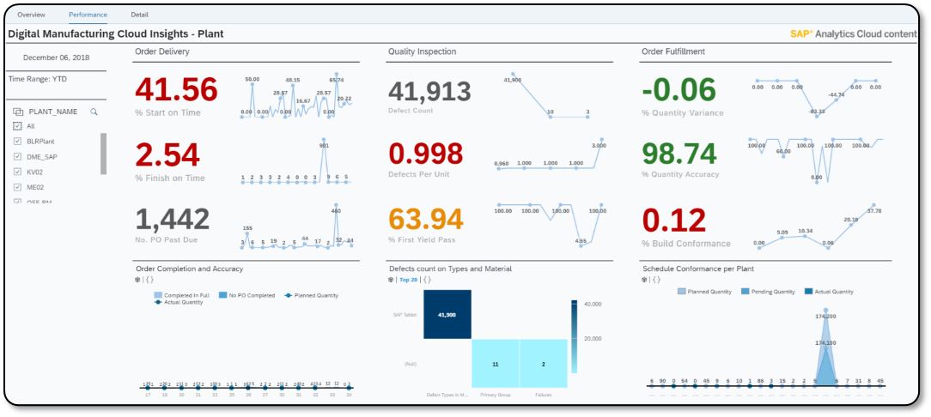
  Analyze…SAP Digital Manufacturing for insights
  Intelligent insights and analysis across global plant operations
Harmonized data and analytics for key performance indicators across a single plant or global operations
Combined business and operational data from ECC, S/4HANA and the Manufacturing Suite for improved decisions
Enable customer-specific processes for planning, execution, maintenance and quality
Notes:
Adaption to any manufacturing process and global visibility and analytics for key performance indicators across a single plant or global operations
Manage and view harmonized data acquired from disparate sources for better visibility into your plant operations
Full integration to combined business and operational data from ECC, S/4HANA and the Manufacturing Suite for improved decisions
Business logic orchestration to enable customer-specific processes for planning, execution, maintenance and quality
Manufacturing Performance Management with OEE Energy Management to lower operational costs through an intuitive tailored Worker UI

Slide 18
Improve
Collaborate with suppliers and other stakeholders for quality issue resolution

Slide 19
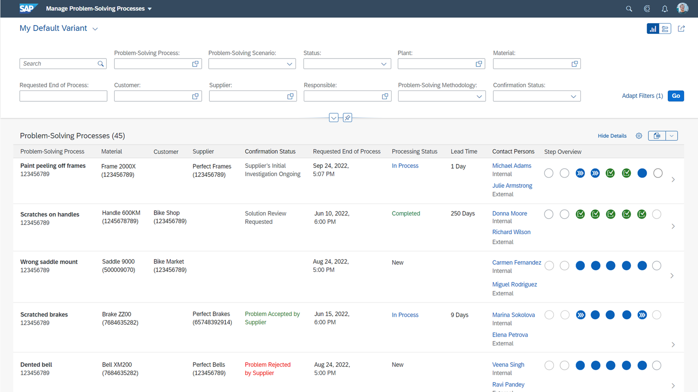
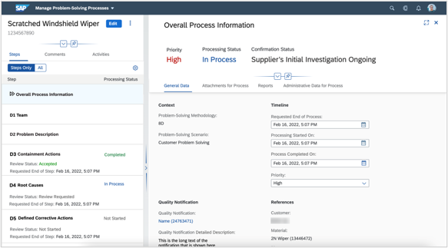
  Improve…SAP Quality Issue Resolution
Solve and prevent quality issues in collaboration with internal and external stakeholders
Use of predefined industry standards to solve issues
Root-cause analysis to pinpoint causes of defects
Visibility and collaboration capabilities from identification to resolution
Notes:
Process quality issues efficiently by determining the main root causes to enable corrective and preventive measures in order to lower future quality costs.
Identify, analyze and verify the real causes of a problem, using methods such as 5Whys. Root Cause analysis helps to subsequently track the mitigation process and supports prevention.
Maintain and improve quality consistently. Strengthen the quality of products with standardized problem-solving processes and increase efficiency through a close collaboration with internals, external suppliers and customers.
Benefit from end-to-end processes with the integration in quality management from SAP S/4HANA.
Use the industry standard Eight Disciplines of Problem Solving (8D) methodology and its predefined process steps to identify, correct, and solve recurring problems, making it useful in product and process improvement.
Root cause analysis helps to identify and document the source of the problem and subsequently track the mitigation process to prevent defects.
Efficiency – has a positive impact on productivity and efficiency by providing visibility and collaboration capabilities throughout the process (identification to resolution).
Pursue problem-solving processes efficiently in collaboration with stakeholders. With pre-defined steps based on standardized methodologies, such as 8D, the quality of products can be ensured.
Benefit from end-to-end processes with the integration to quality management from SAP S/4HANA

Slide 20
Protect
Reduce risk with workplace safety, drive sustainable operations, and reduce your environmental impact

Slide 21
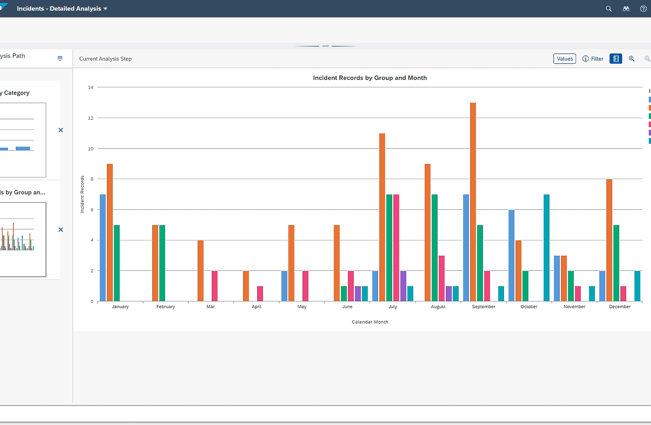
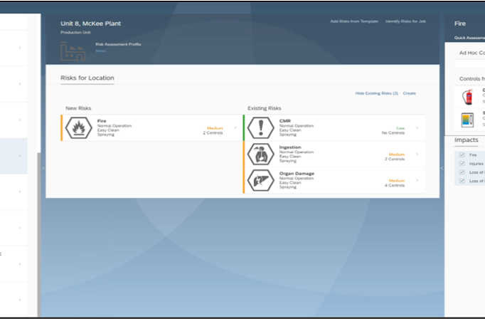
  Protect…SAP S/4HANA for Environment Management and SAP S/4HANA for Workplace Safety
Reduce the risk of incidents with predictive visibility into hazards and improve safety practices
Track the full lifecycle of incidents, from reporting to correction
Repository and task tracking for all compliance requirements
Top-floor to shop-floor insights with real-time analytical tools
Notes:
Track the full lifecycle of all types of incidents from initial reporting and investigation to corrective action
Assess risks through hazard identification, impact assessment, risk rankings, and application of process controls
Mobile and offline options for reporting incidents and hazards for a predictive, proactive safety culture
Robust employee data privacy and protection mechanisms
Repository and task tracking for all regulatory, permit, and policy compliance requirements
Realtime analytical tools within the EHS processes, integrated with the rest of the enterprise to allow true "shop floor to top floor" insight

Slide 22
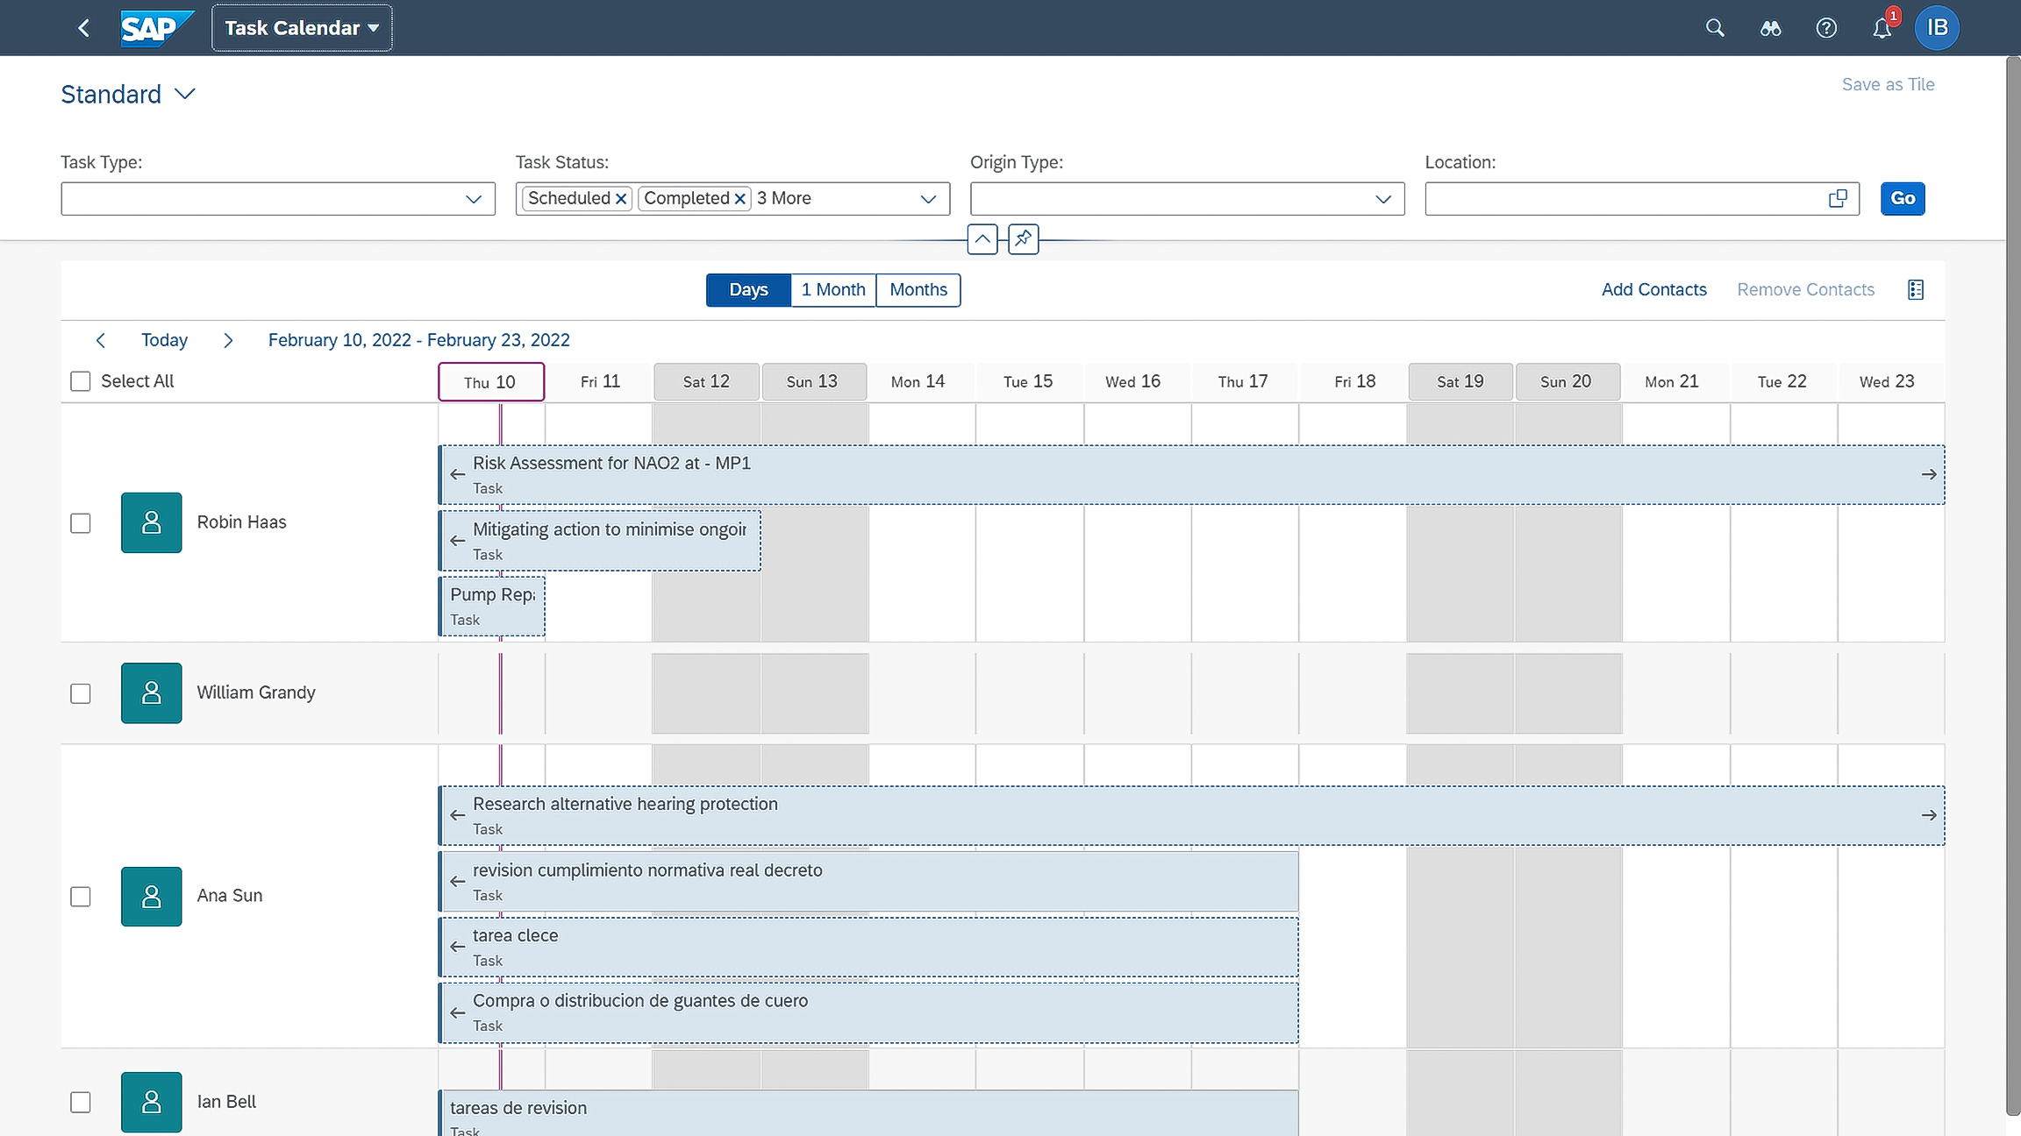
  Protect…SAP S/4HANA for Environment Management and SAP S/4HANA for Workplace Safety
Drive sustainable operations and reduce your environmental impact
Integrated cradle-to-grave waste management
A flexible and auditable calculator for hazardous air pollutant and greenhouse gas emissions
Real-time analytical tools and support for ESG and sustainability reporting
Notes:
Many options for collecting data and sampling to be used for compliance tracking and emission calculations
Cradle-to-grave waste management integrated to logistics and transportation processes
Built-in equations and content driving a flexible and auditable calculator for hazardous air pollutant and greenhouse gas emissions inventories
Repository and task monitoring for all regulatory, permit, and policy-based compliance requirements
Emissions forecasting tools
Realtime and analytical tools and support for ESG and sustainability reporting

Slide 23
Name
name@sap.com

Slide 24
Headline
Use format for your case studies
Copy
  Bullet level one
    Bullet level two
      Subhead

Slide 25
  Execute…SAP Manufacturing Execution
Automate processes and resources to improve manufacturing efficiency, quality and productivity
Utilize intuitive user interfaces (UI) for production operators and transform to paperless production, lowering cost and increasing productivity.
Non-conformance management including in-line sampling, visual test and repair
Flexible demand integration support for high-volume (repetitive) manufacturing through to high-mix lot size of 1 manufacturing requirements
Configurable OEE Time Model and Reason codes to support customer specific time models and quick options for operator to trigger maintenance notifications and machine status change
Easy integration “out of the box” to SAP ERP and via SAP Plant Connectivity to the shop floor

Slide 26
  Execute…SAP Manufacturing Execution with Resource Orchestration
Automate processes and resources to improve manufacturing efficiency, quality and productivity
Enable resource orchestration by dispatching and sequencing operations to compress the manufacturing lifecycle and provide real-time production performance tracking
Implement top-floor to shop-floor scenarios to achieve rapid return-on-investment through out-of-the-box integration to SAP solutions
Utilize intuitive user interfaces (UI) for production operators and transform to paperless production, lowering cost and increasing productivity.
React quickly to unexpected events by monitoring the entire manufacturing process to optimize resources and speed execution utilizing built-in intelligence
Collaborative integration to allow you to respond quickly to unexpected events

Slide 27
  Analyze…SAP Manufacturing Integration and Intelligence
Standardize Performance Across Operations
Adaption to any manufacturing process and global visibility and analytics for key performance indicators across a single plant or global operations
Full integration to combine business and operations data from S/4 (and ECC) to track and manage loss analysis in order to focus in on where the biggest efficiency losses are occurring, identifying their root cause and the correcting them
Manage and view harmonized data acquired from disparate sources for better visibility into your plant operations and standardization of the definition of production
Standard logic is quickly and easily extended to fit local production processes and systems in order to assimilate their data into the analysis and ensure consistency in their operation without being disruptive to the existing systems & processes
Manufacturing Performance Management centered around a common definition of OEE & Energy Management to lower improve efficiency, lower operational costs, and drive investments to the areas in the plants that need it most

Slide 28
Appendix

